Slide 1

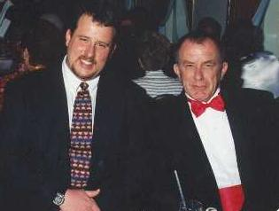
Exposure CS 2021
for CS1
Chapter 18 Section 6-7 Slides
More Graphics:
Computer Animation & The Last Word
PowerPoint Presentation
created by:
Mr. John L. M. Schram
and Mr. Leon Schram
Authors of Exposure
Computer Science

Slide 2











Section 18.6

Slide 3
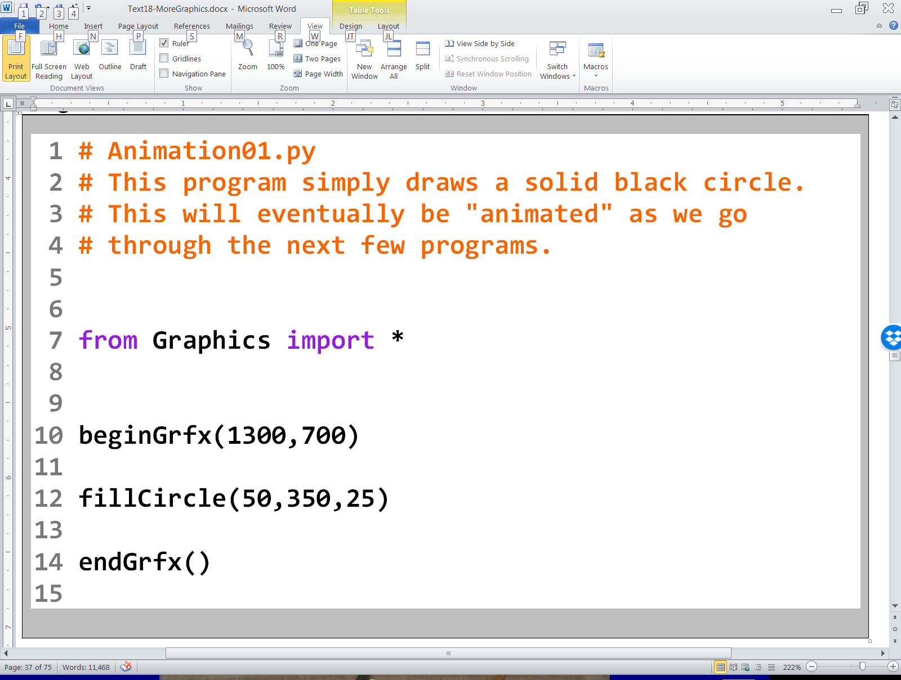
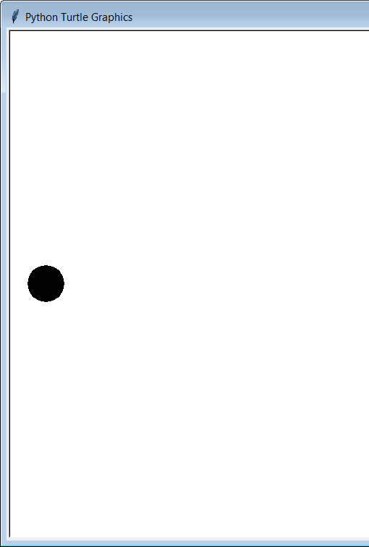

Slide 4
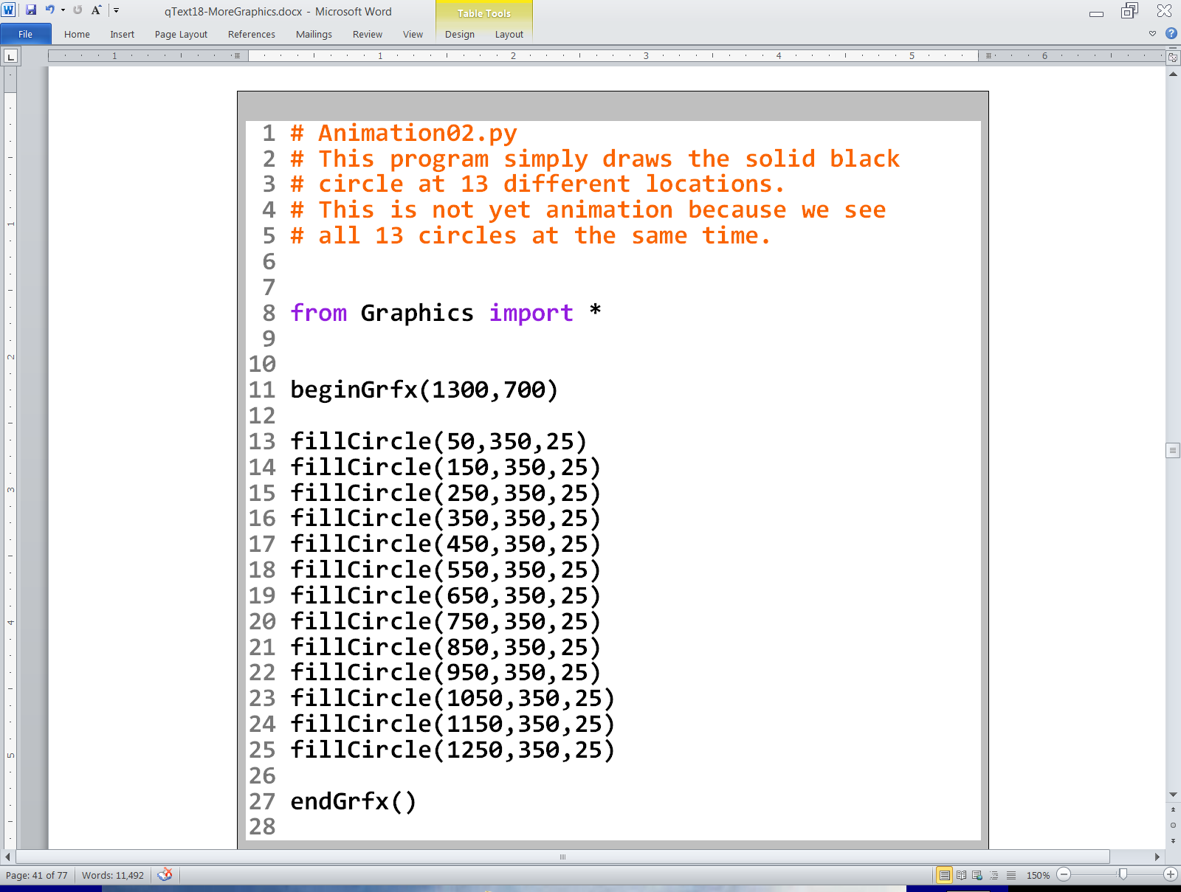

Slide 5
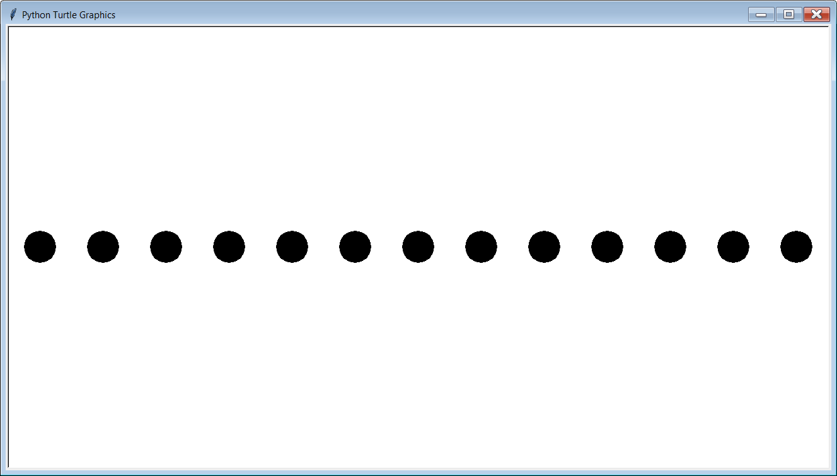

Slide 6
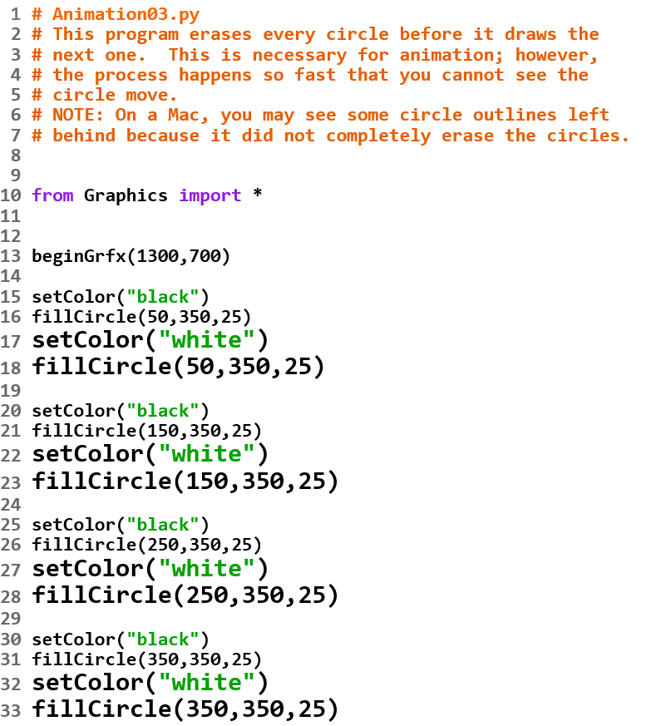
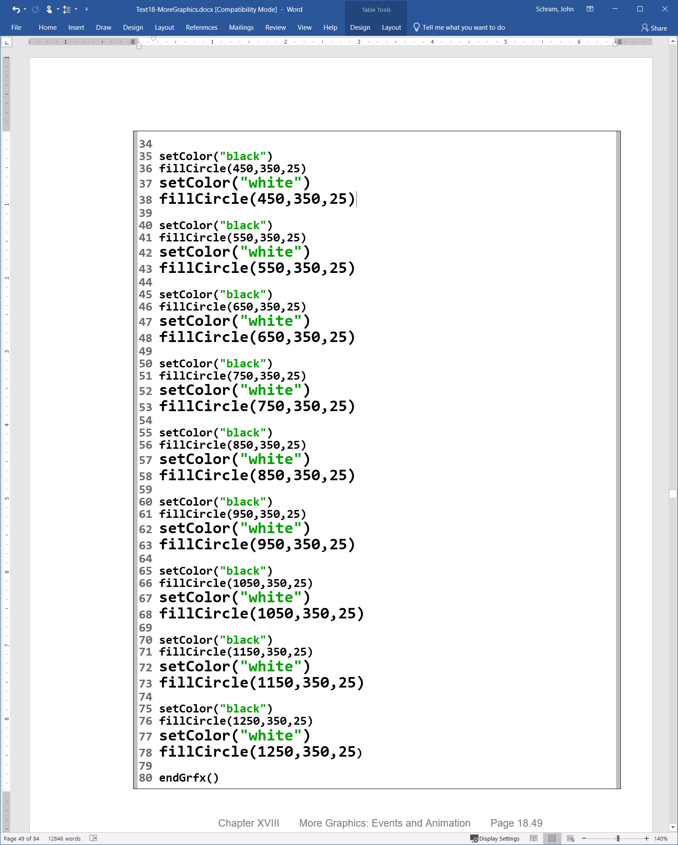


Slide 7
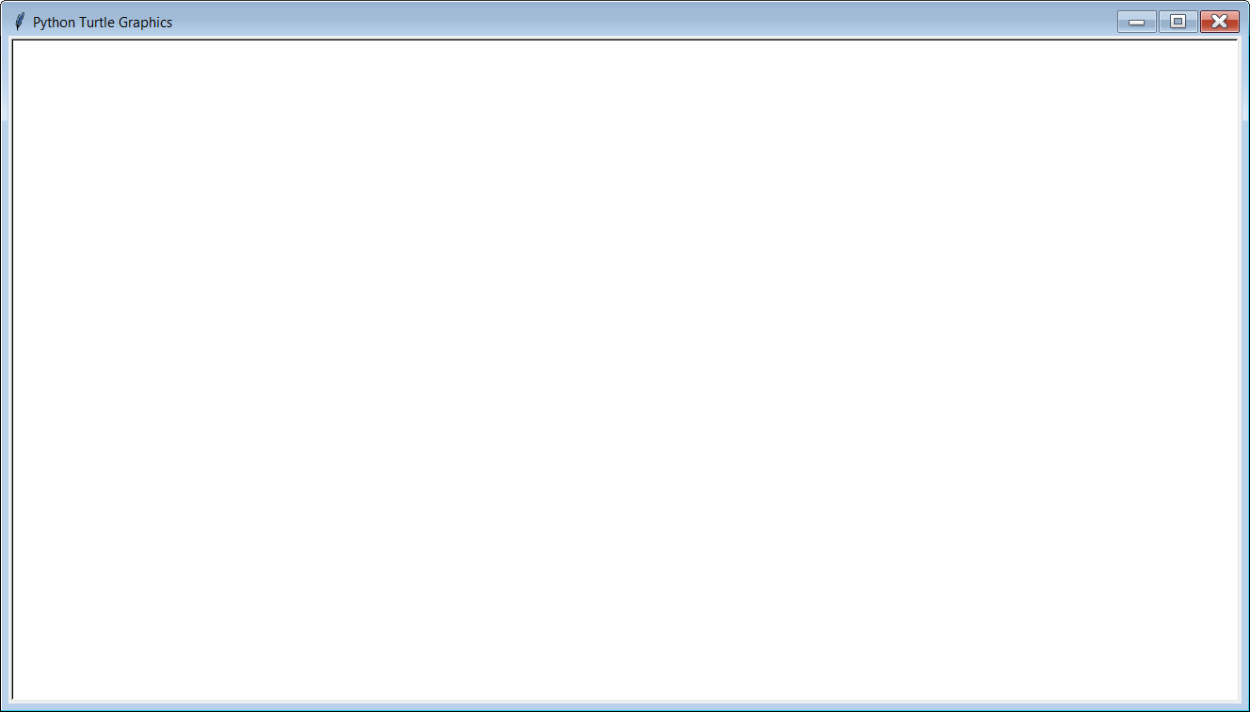
Windows PC Output:
The circle did move
across the screen,
but it happened
so fast your eyes
did not have
a chance to see it.

Slide 8
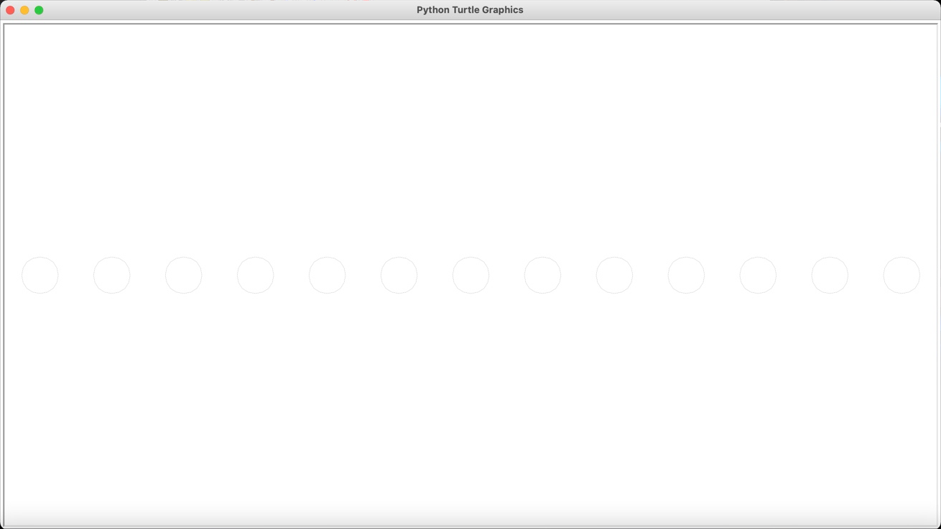
Mac Output:
On a Mac, the circles
are not completely erased.

Slide 9
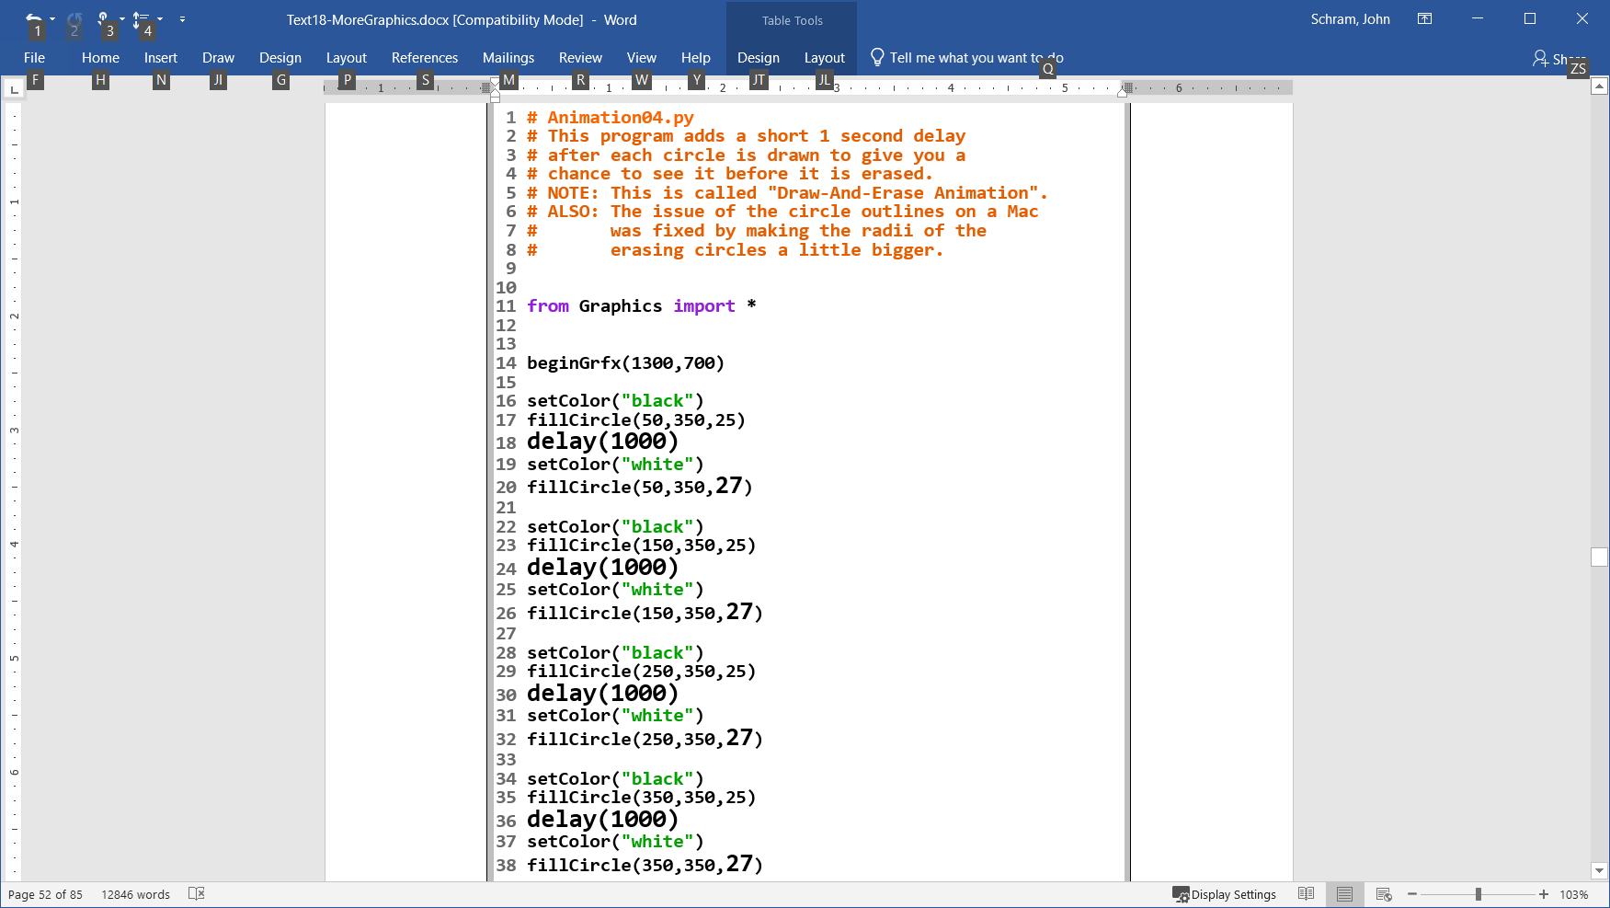
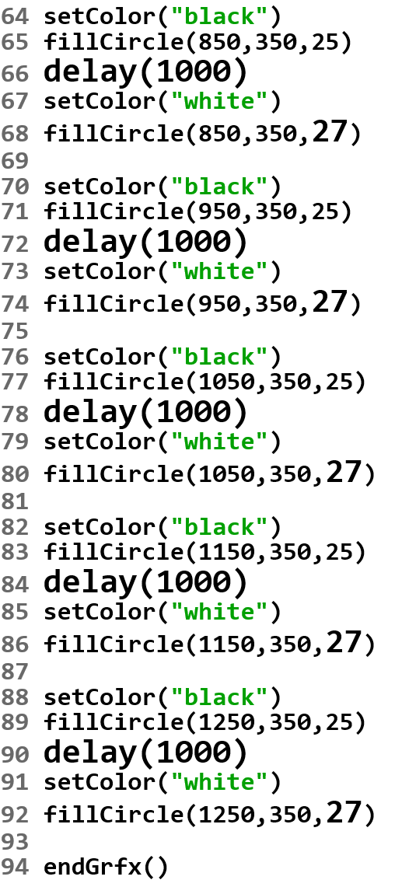
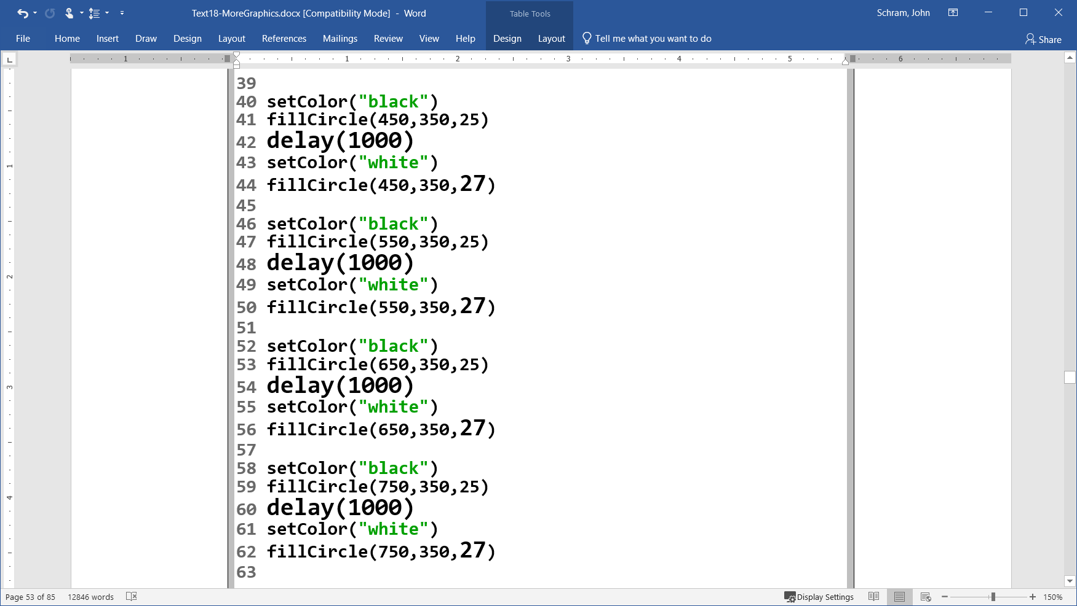

Slide 10


Slide 11
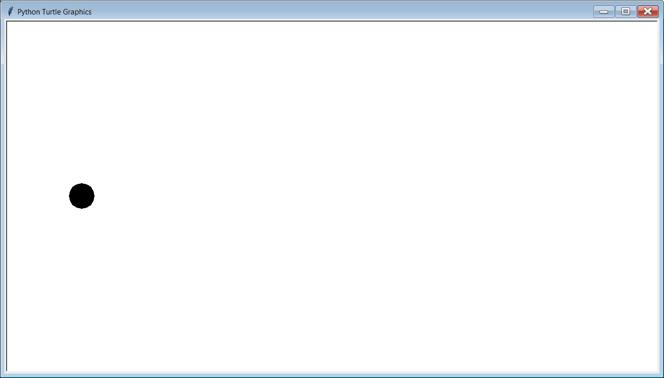

Slide 12
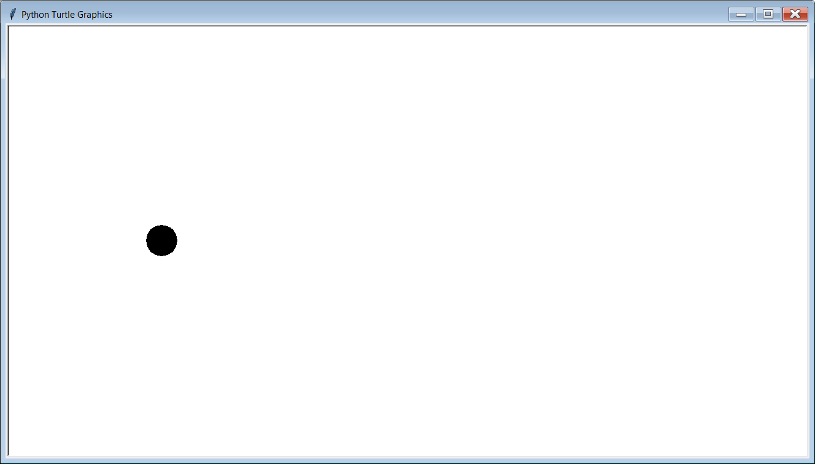

Slide 13
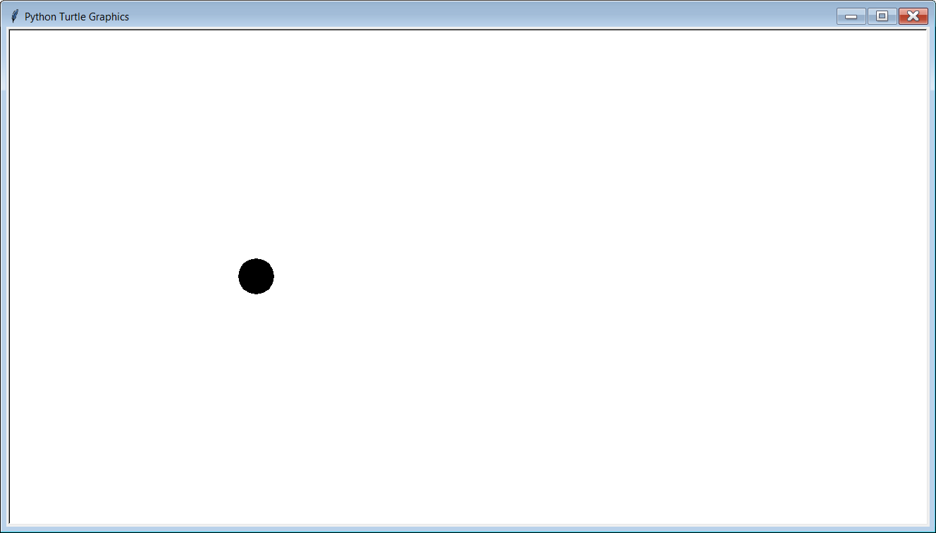

Slide 14
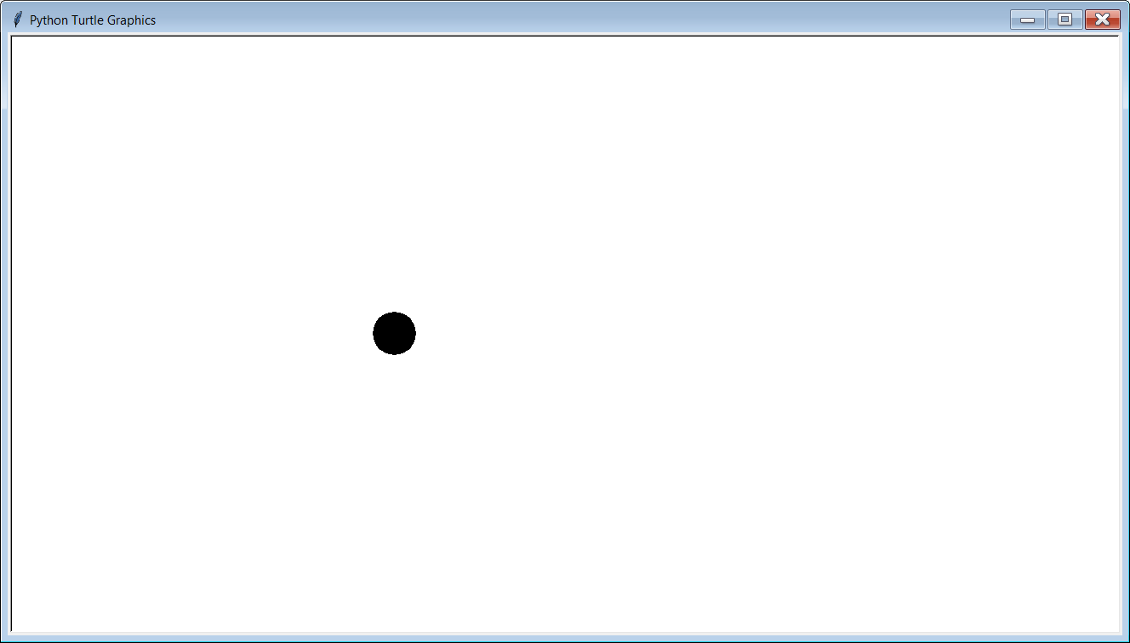

Slide 15
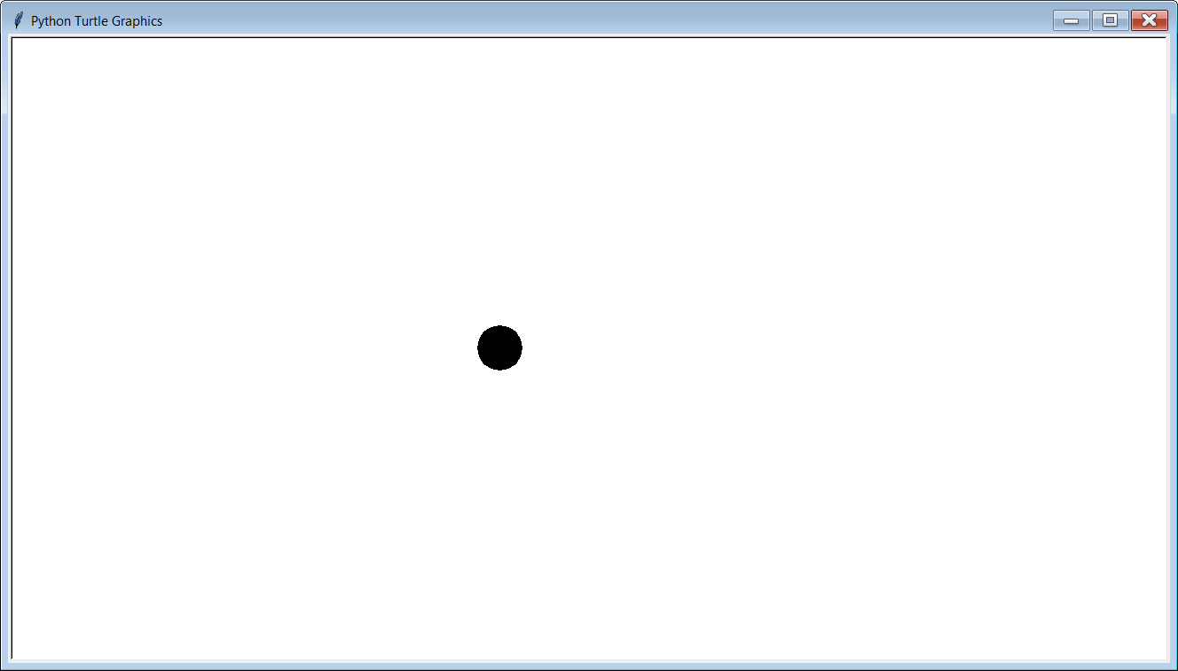

Slide 16
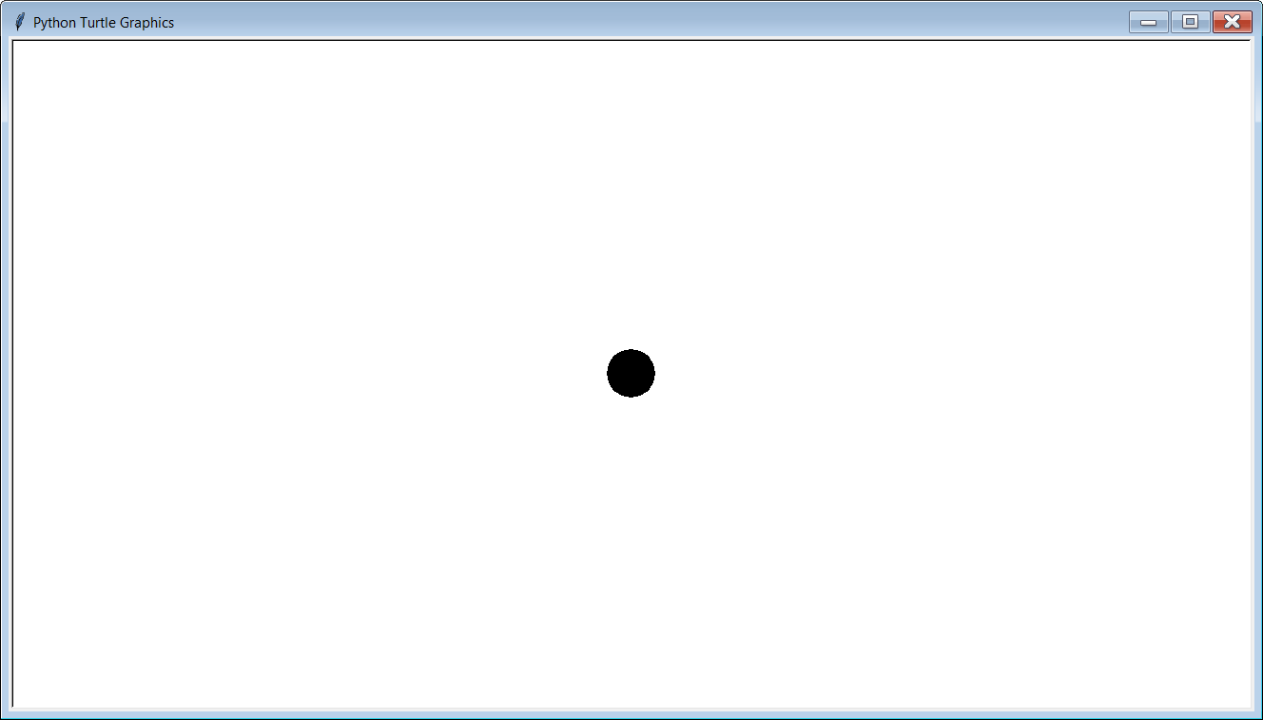

Slide 17
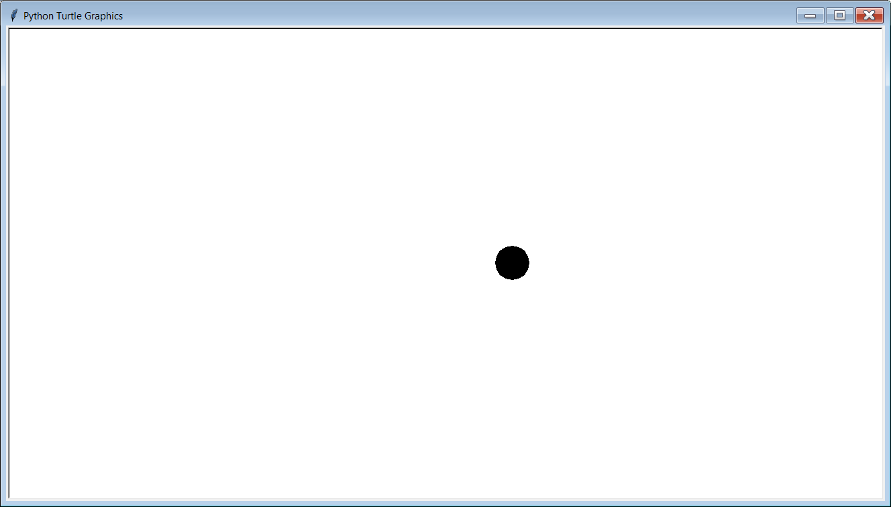

Slide 18
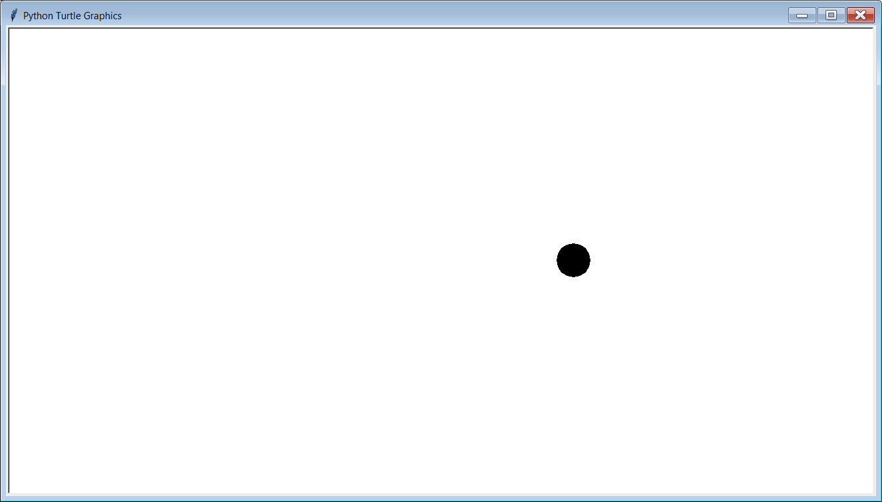

Slide 19
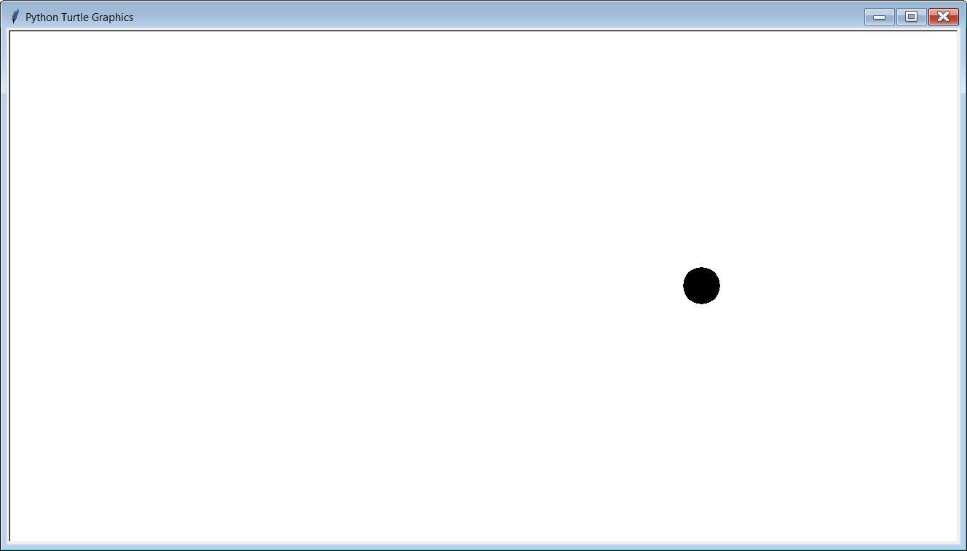

Slide 20
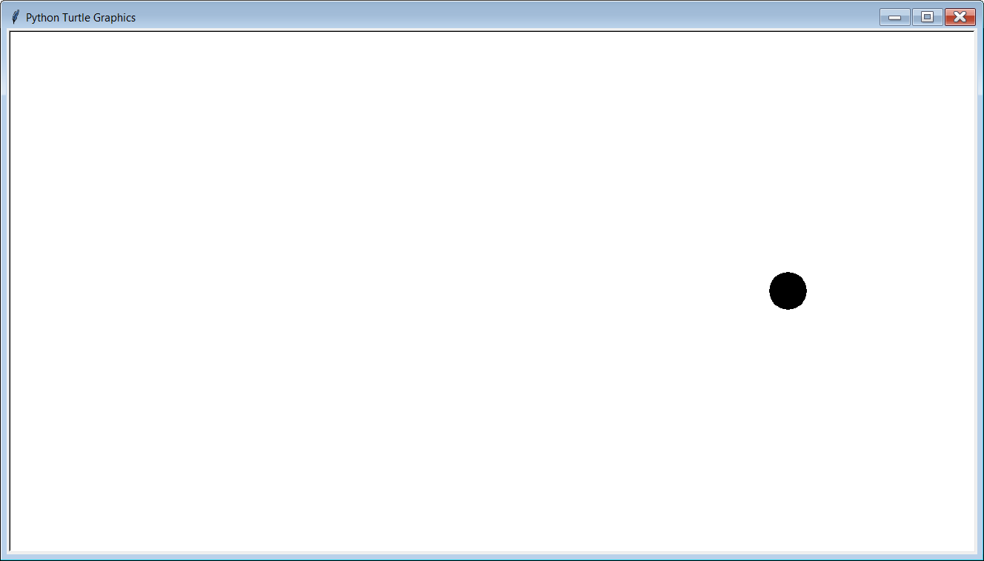

Slide 21
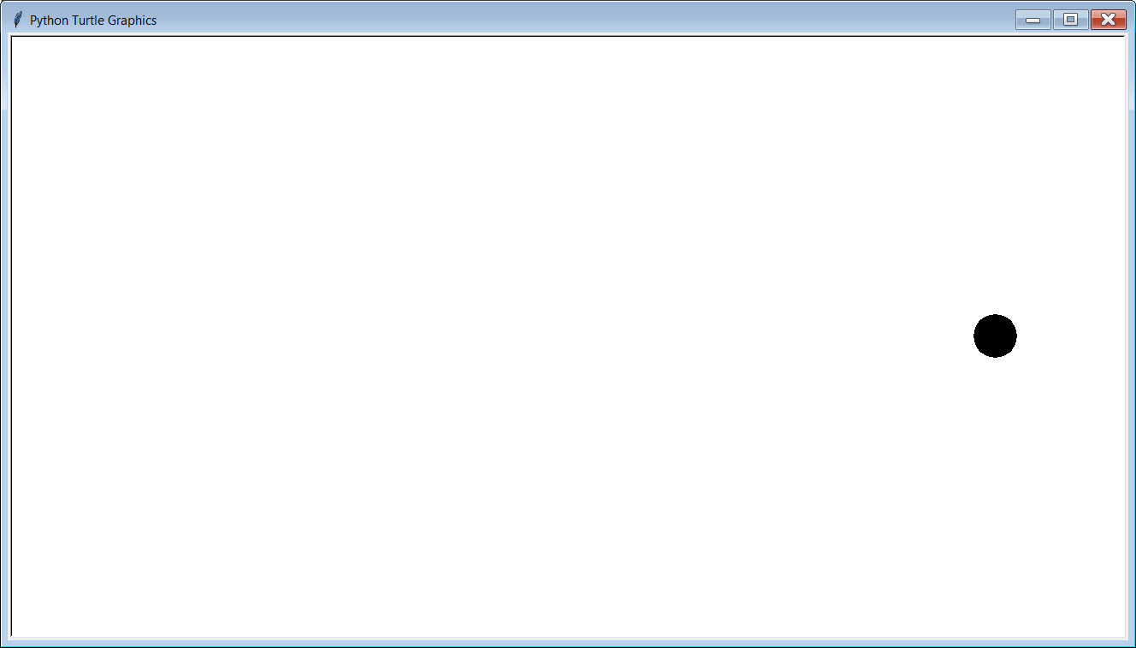

Slide 22
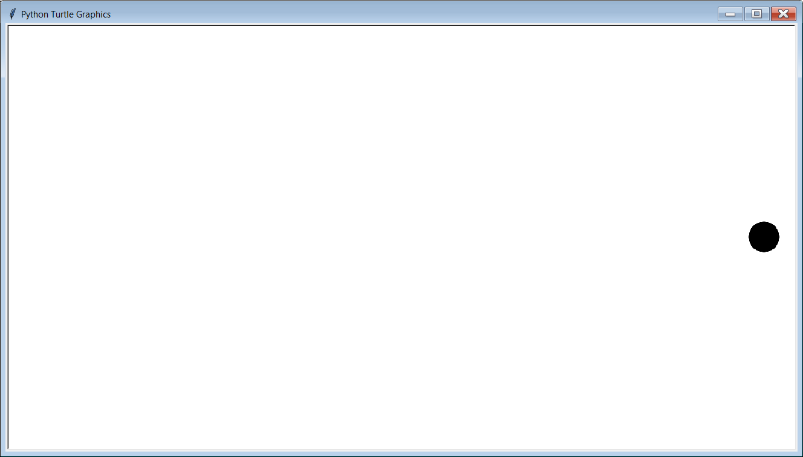

Slide 24

Program Note
The output of program Animation04.py was simulated with PowerPoint.
It will not be possible to simulate the
output of the remaining programs.
You need to execute them on
your own computer to truly
see what they are doing.

Slide 25

Do you see a
pattern here?

Slide 26
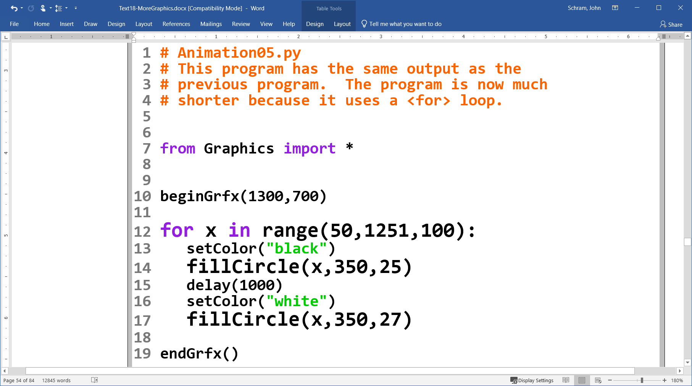

Slide 27
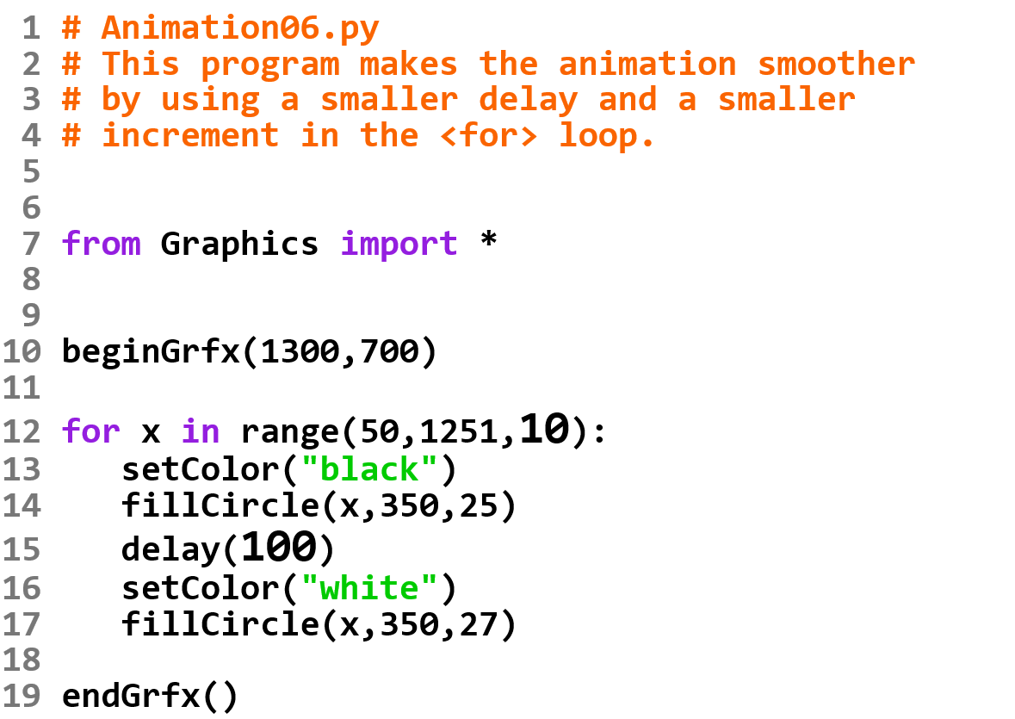

Slide 28
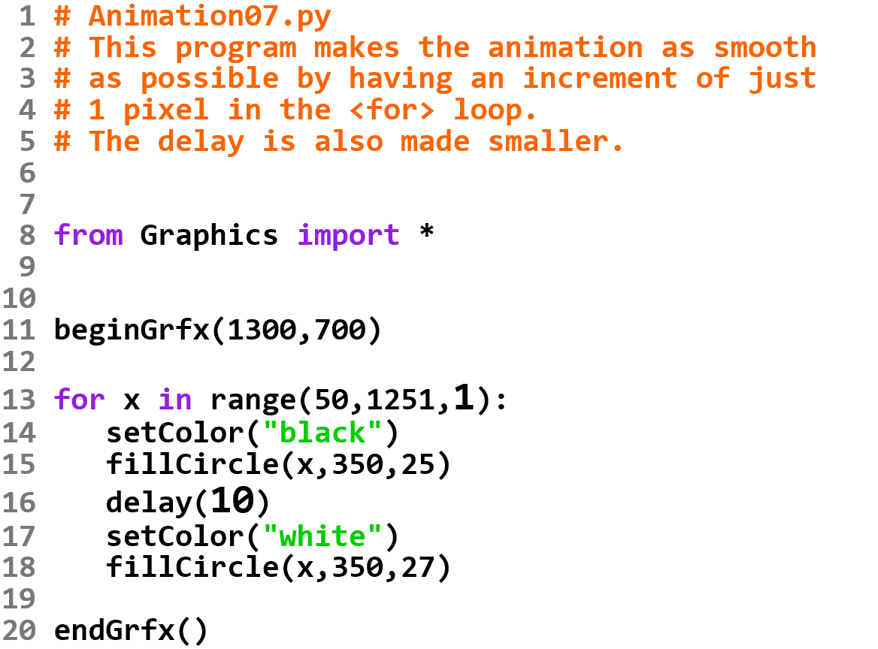

Slide 29
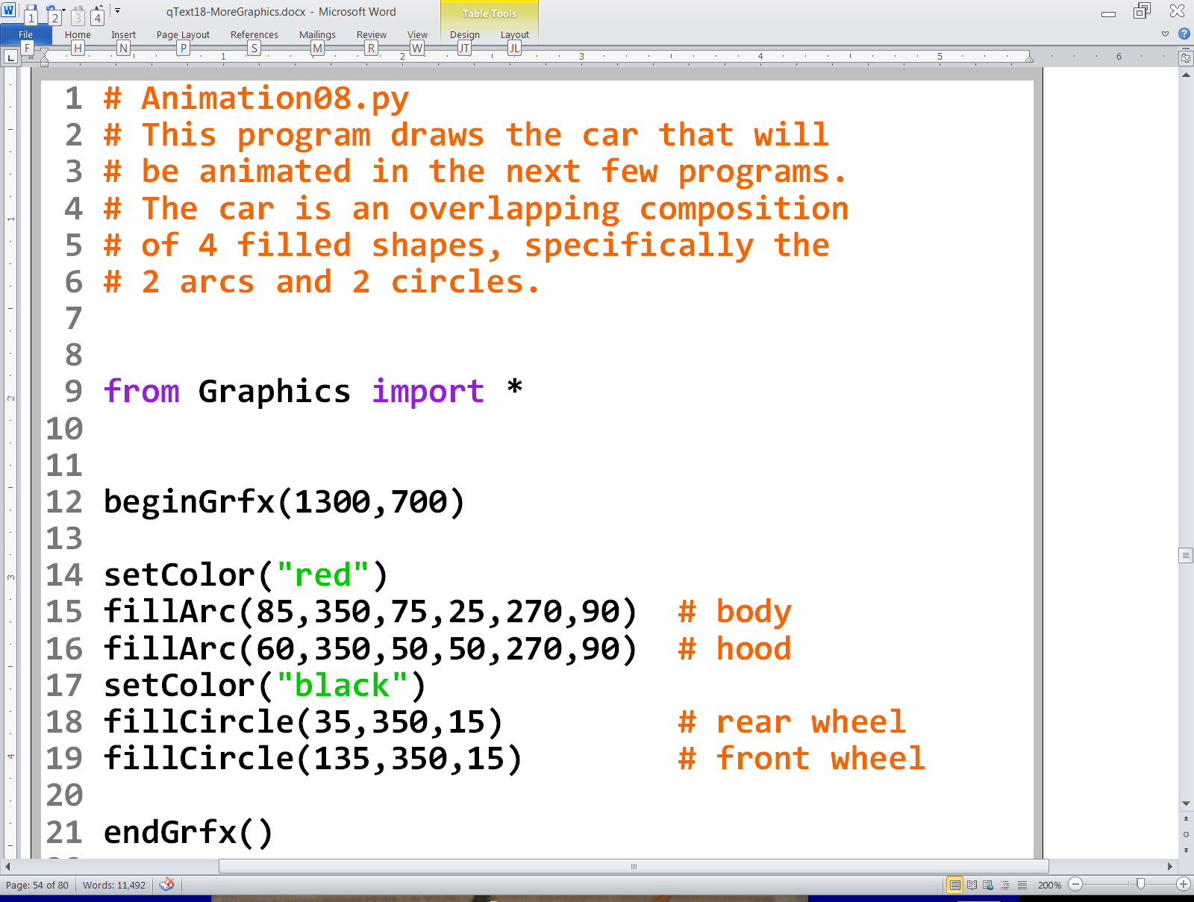
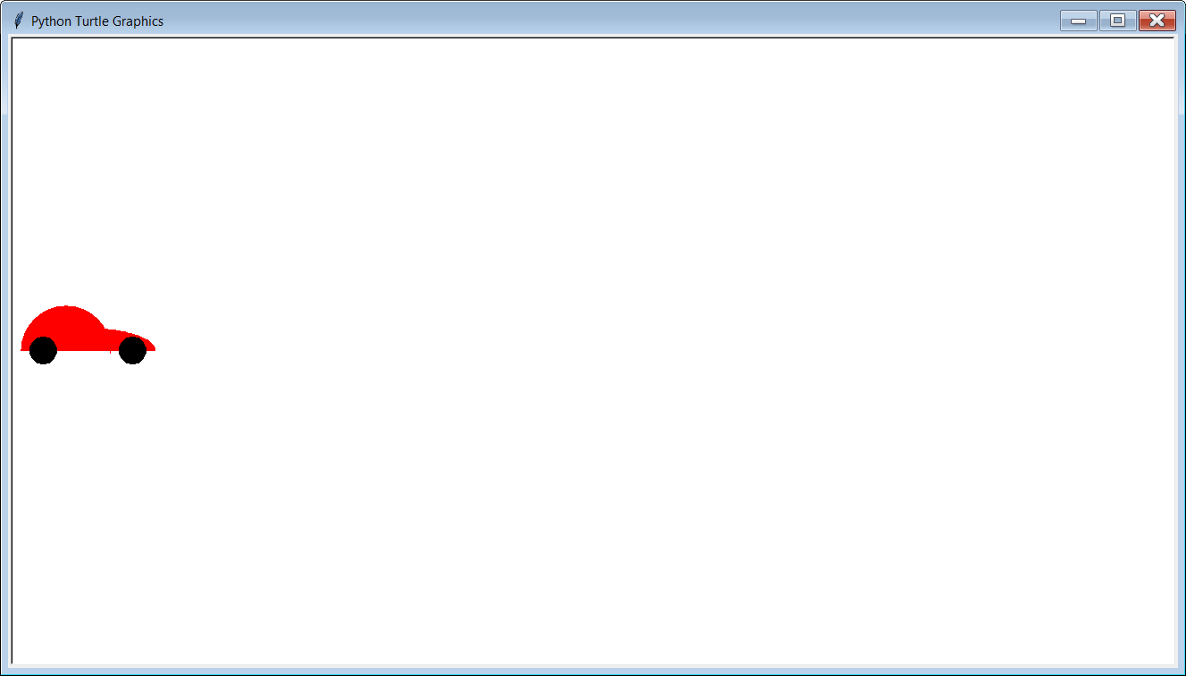
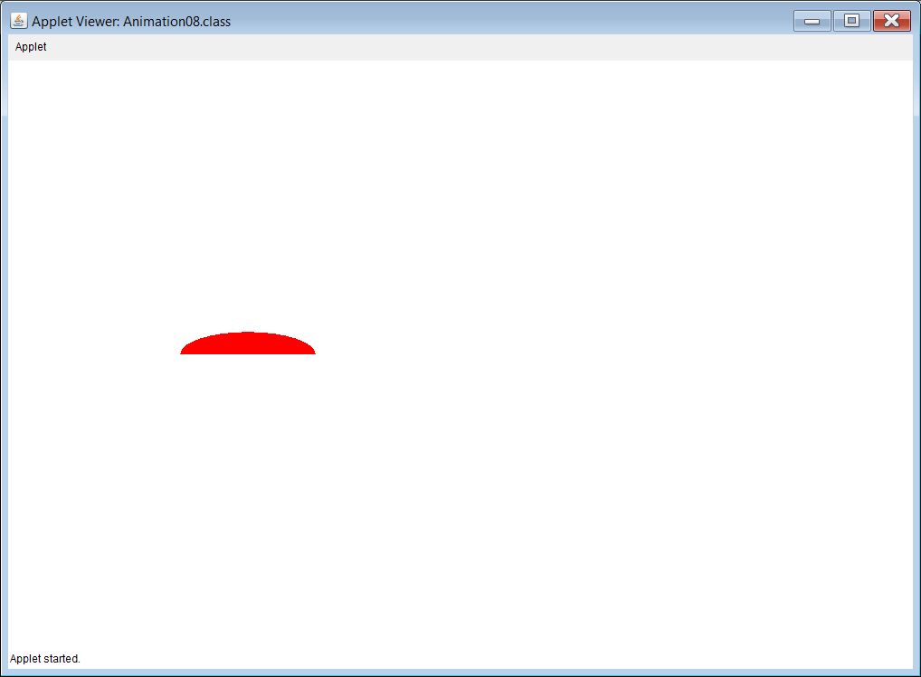
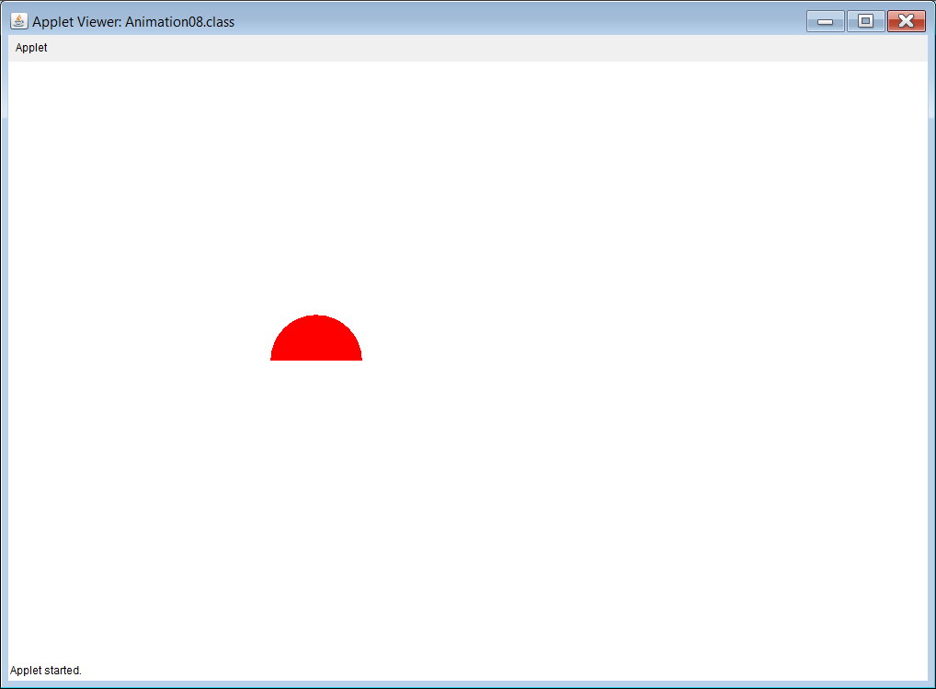
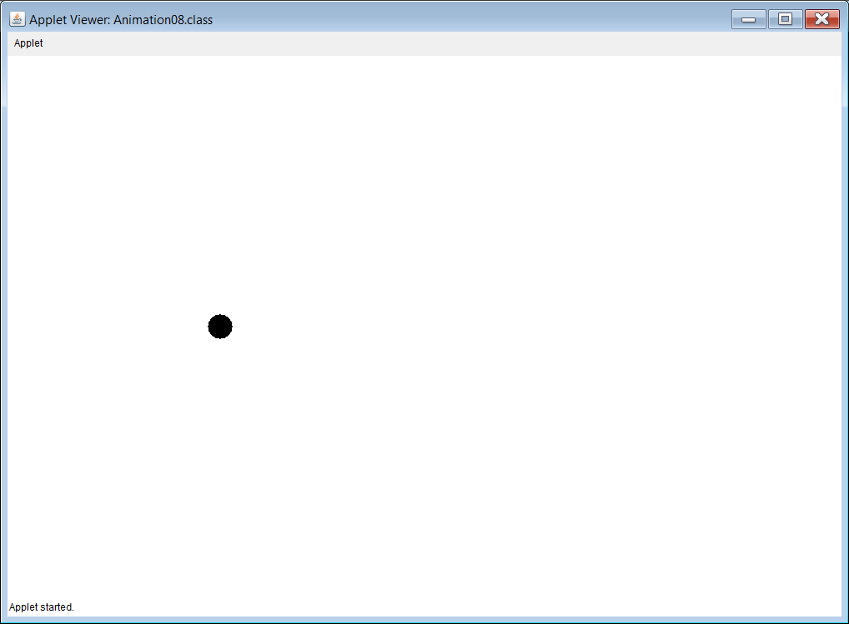

Slide 30
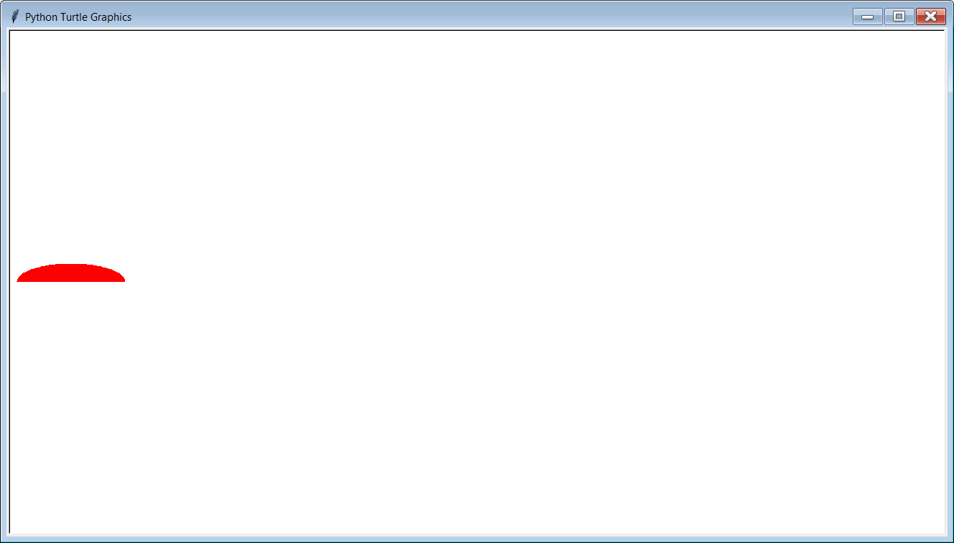
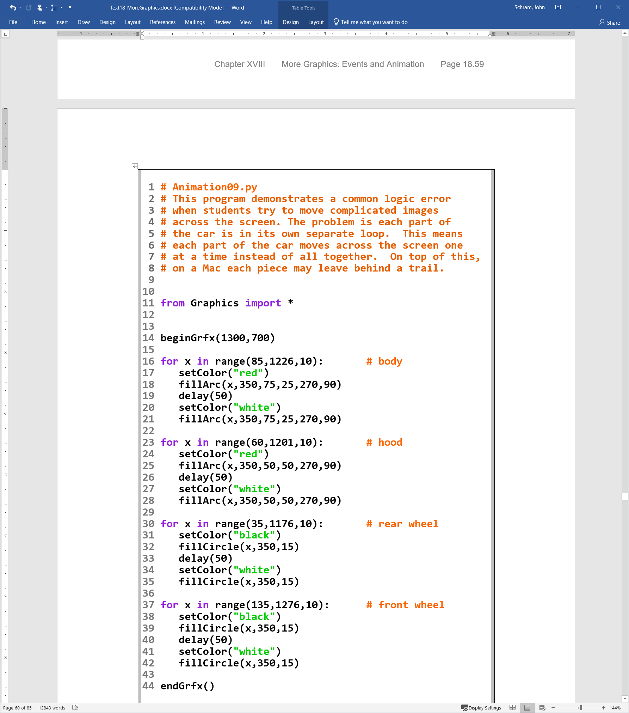
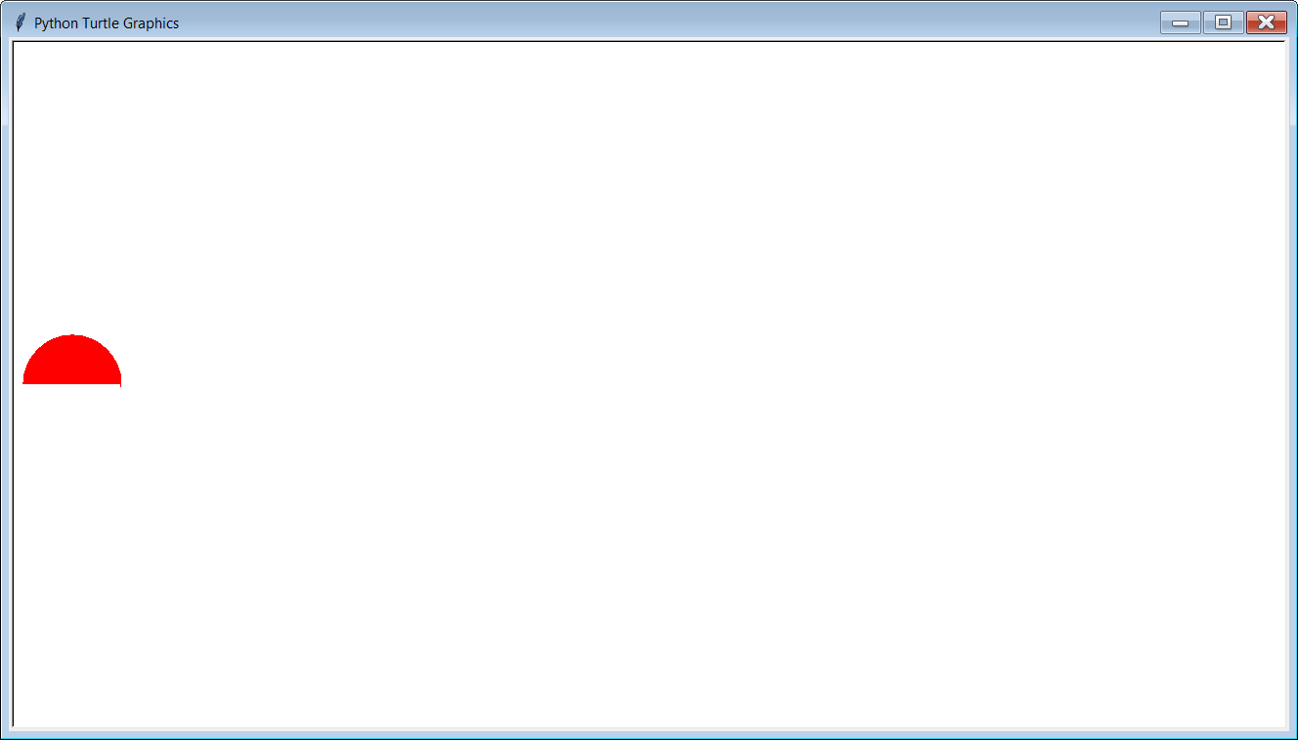
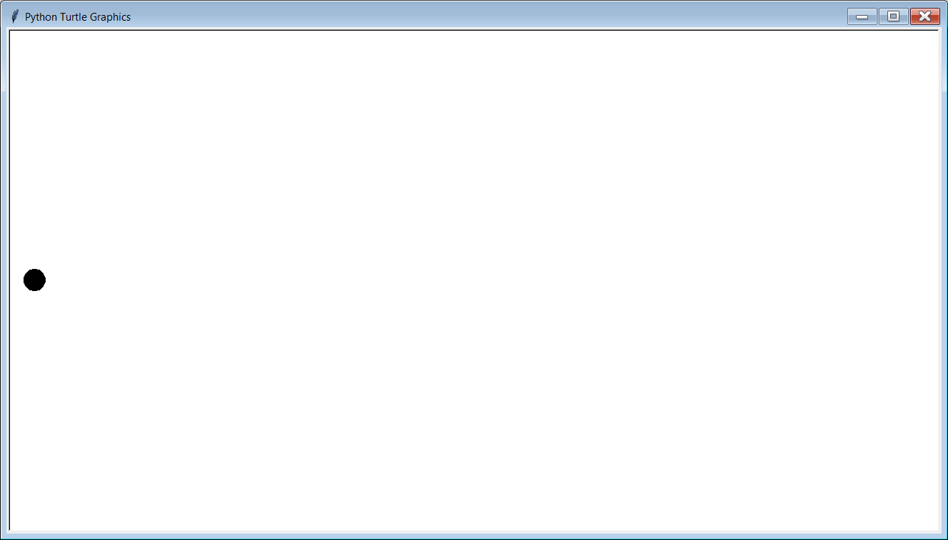
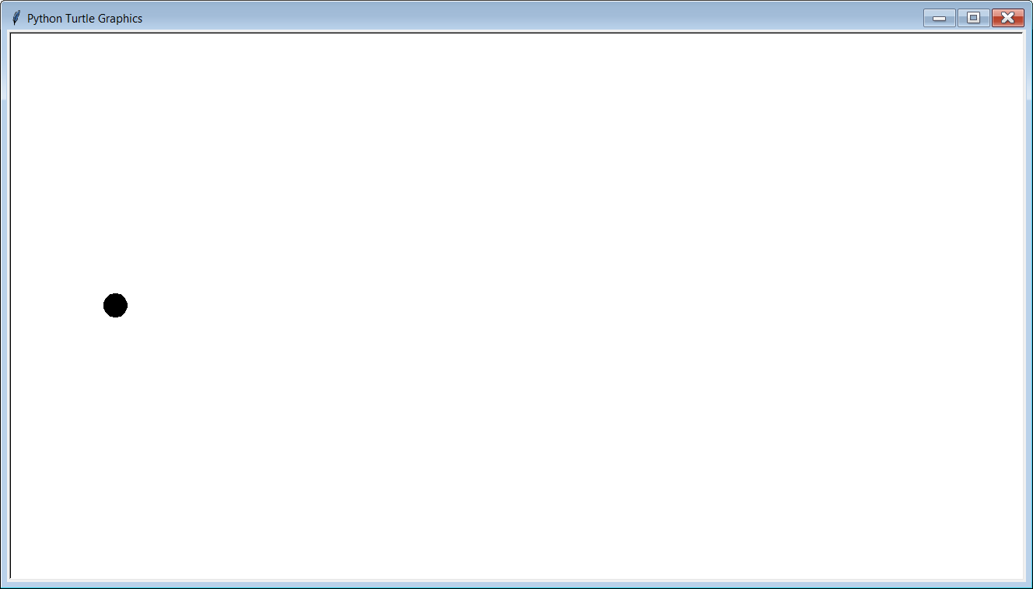

Slide 31
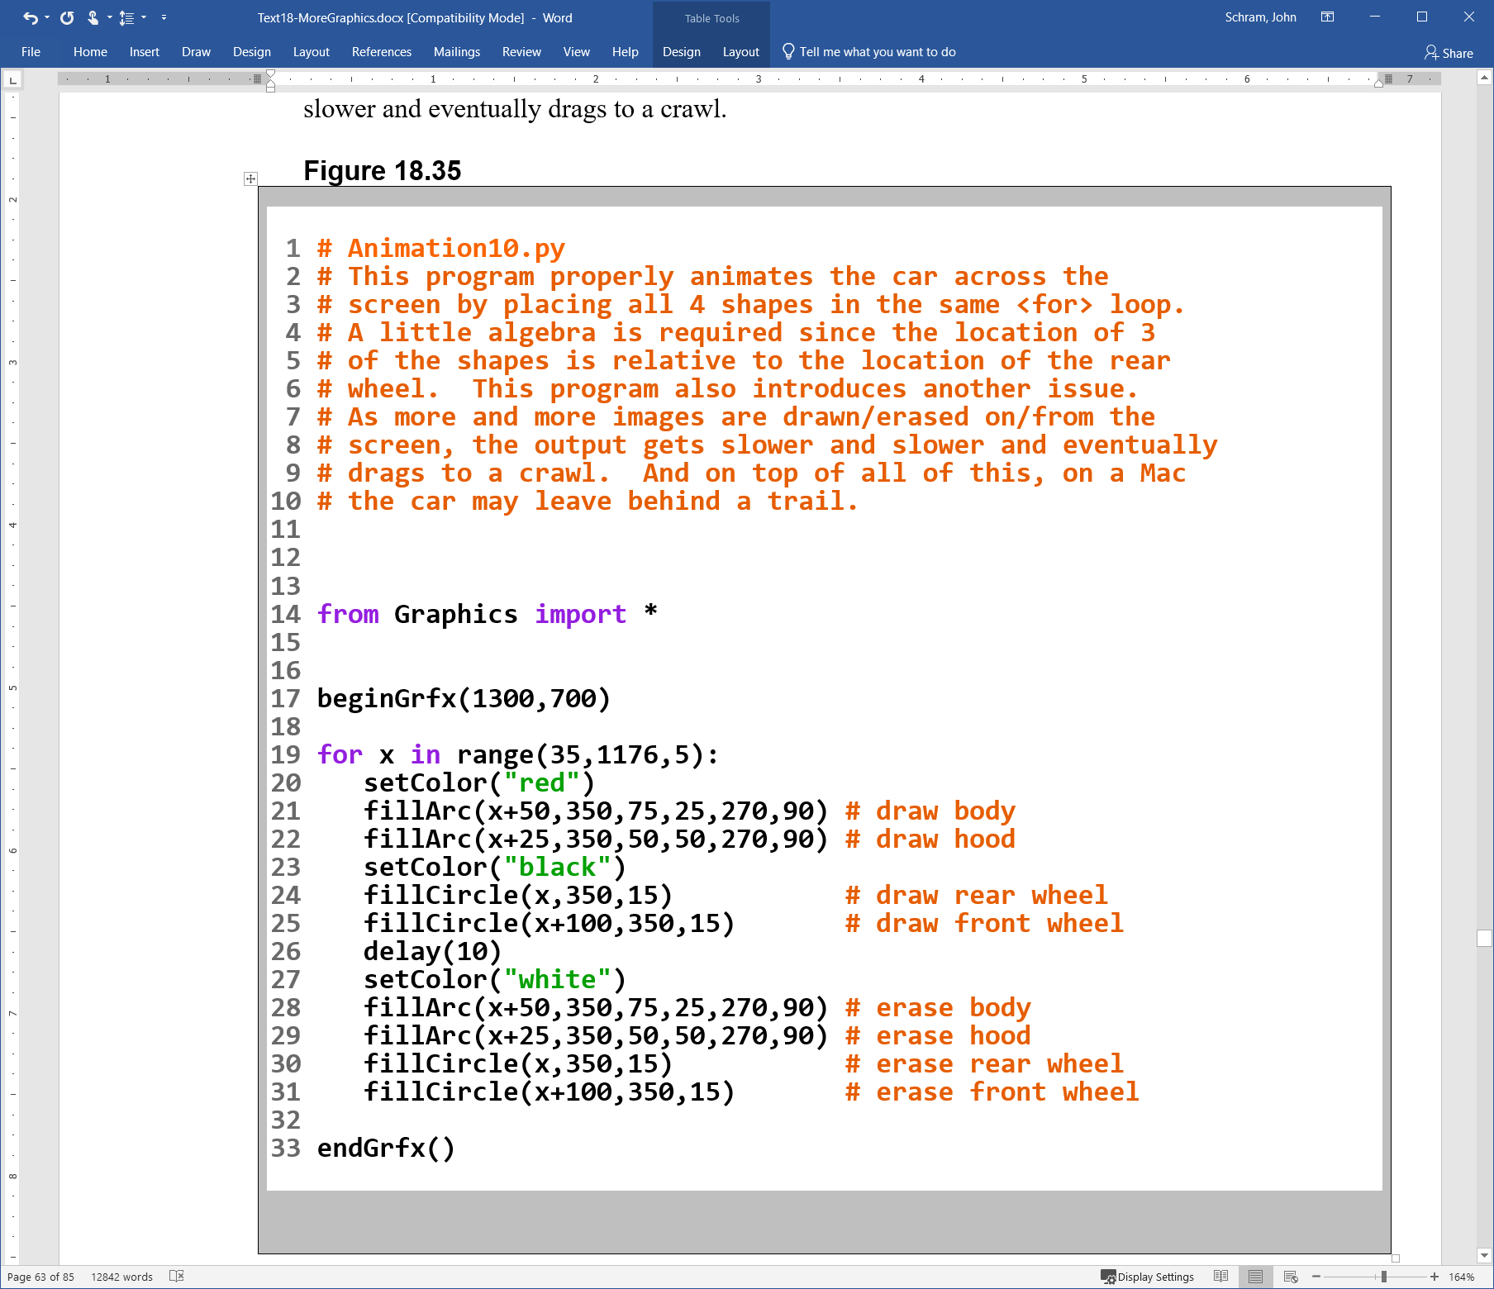

Slide 33
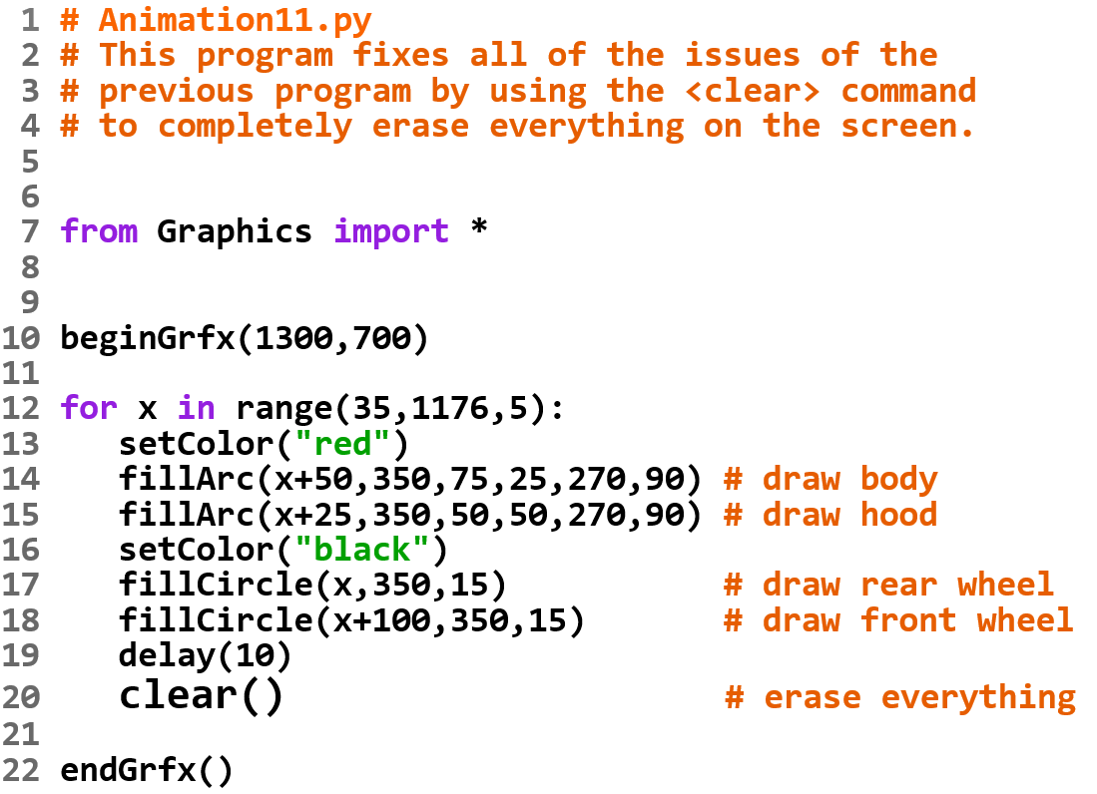

Slide 34
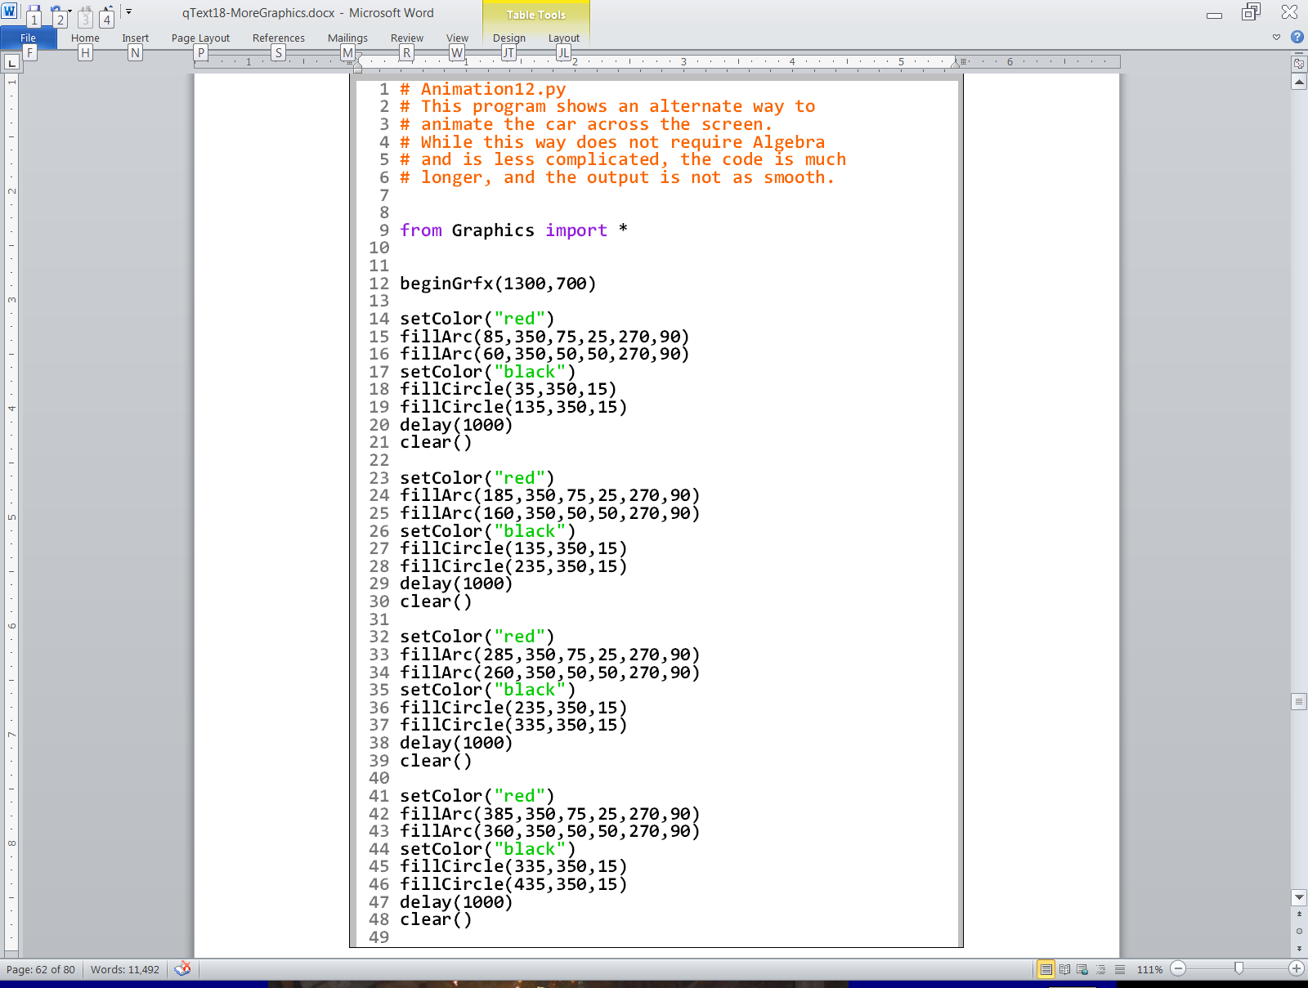
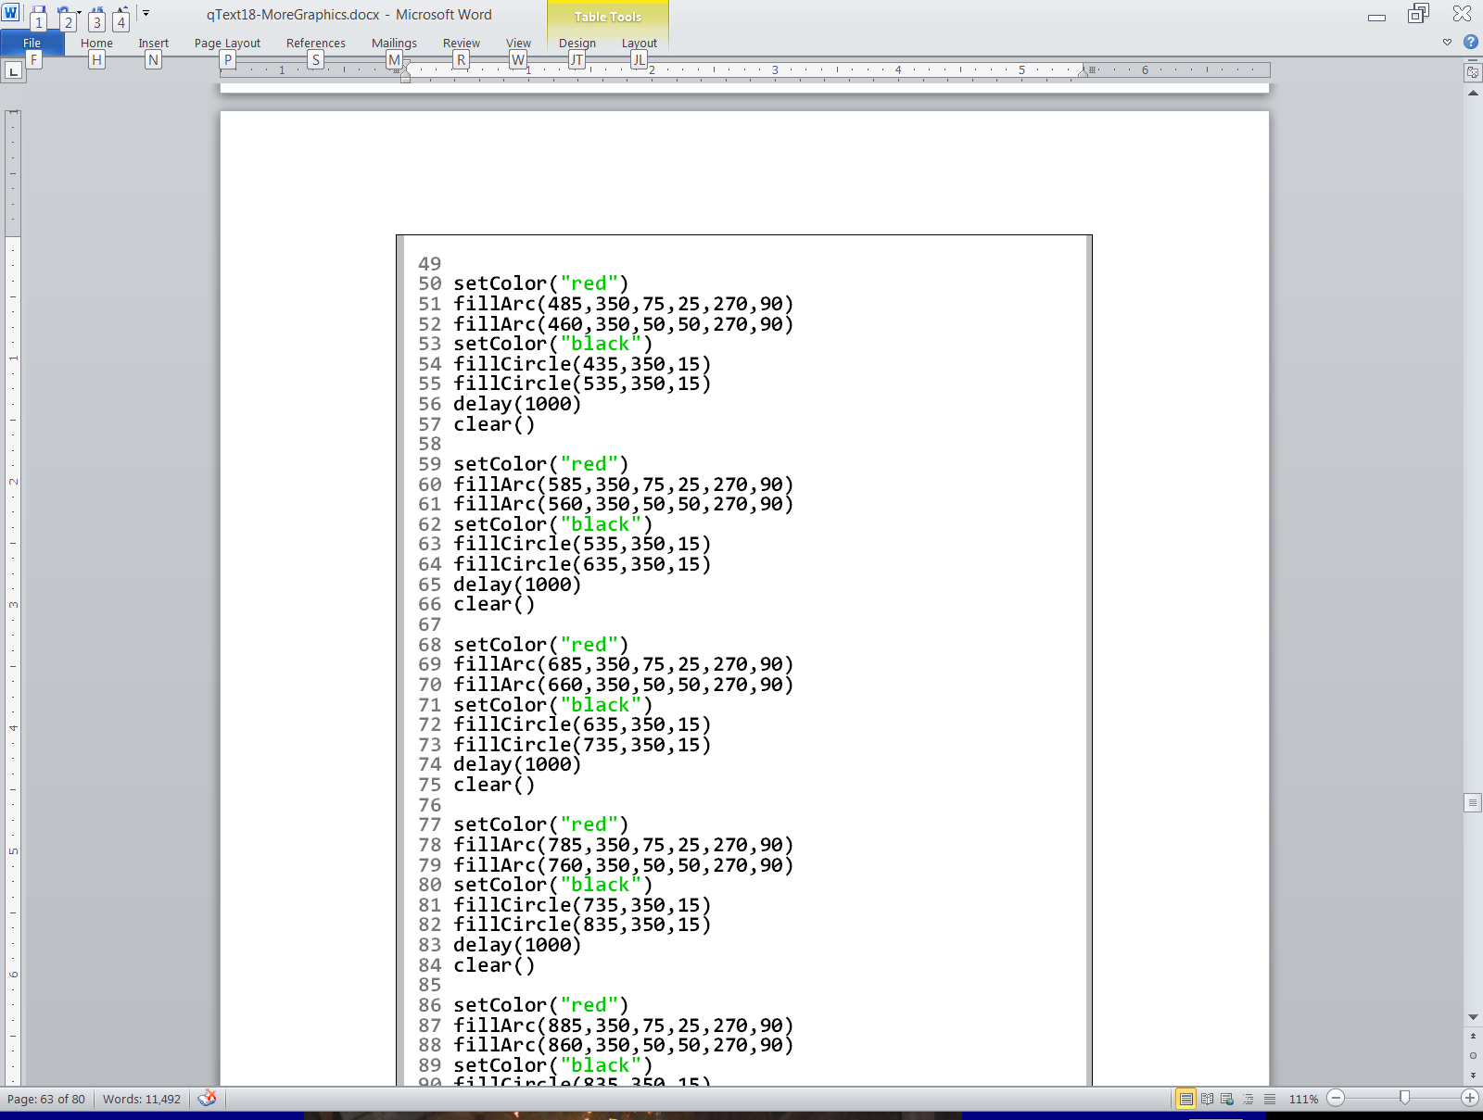
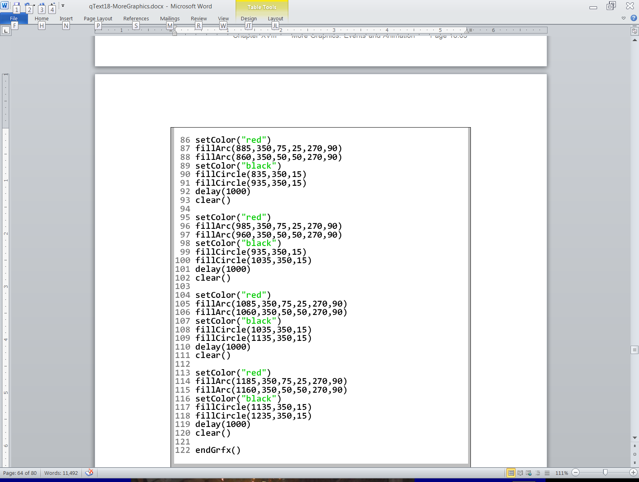

Slide 35
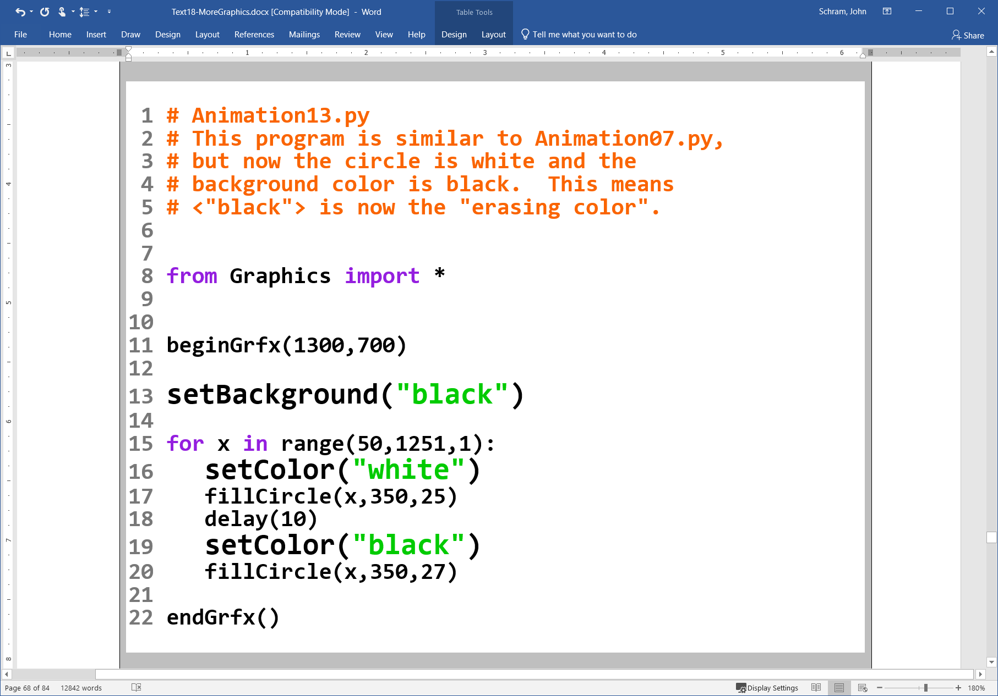

Slide 36
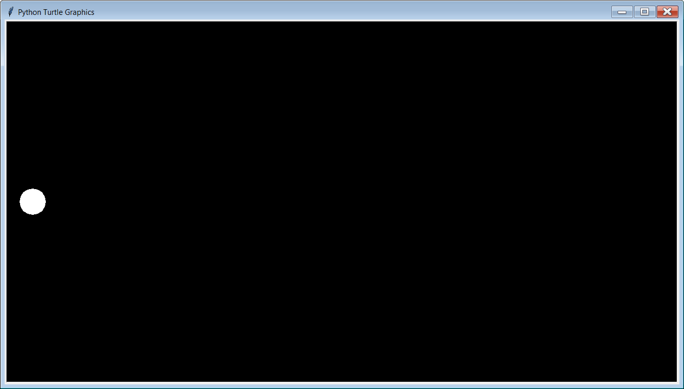

Slide 37
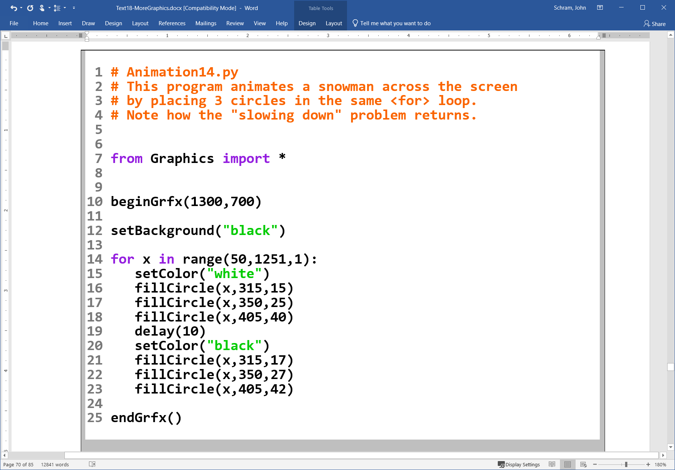


Slide 38
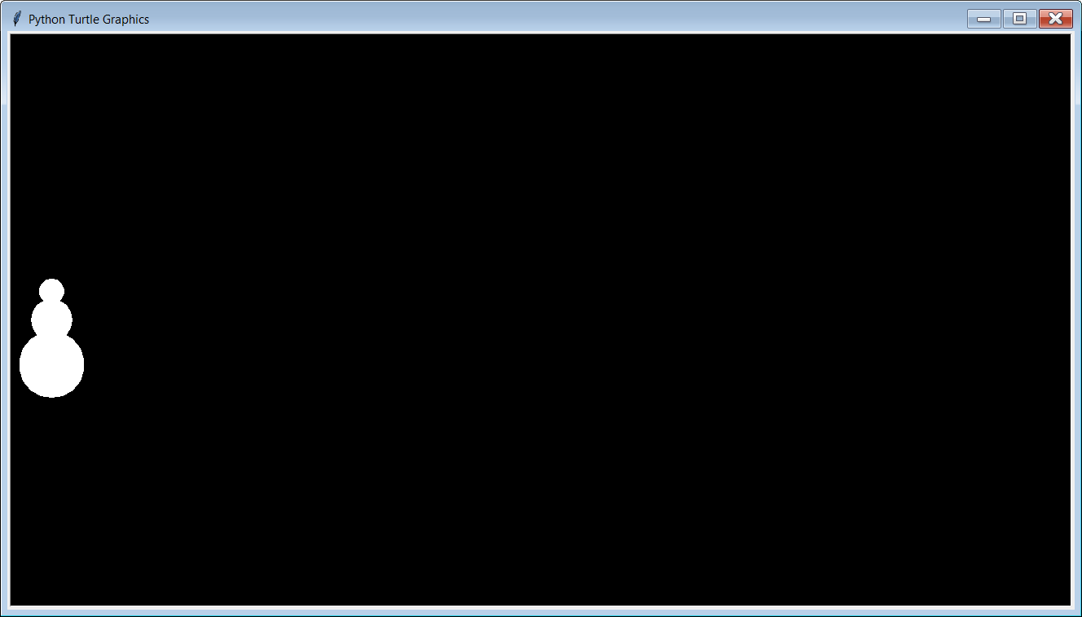

Slide 39
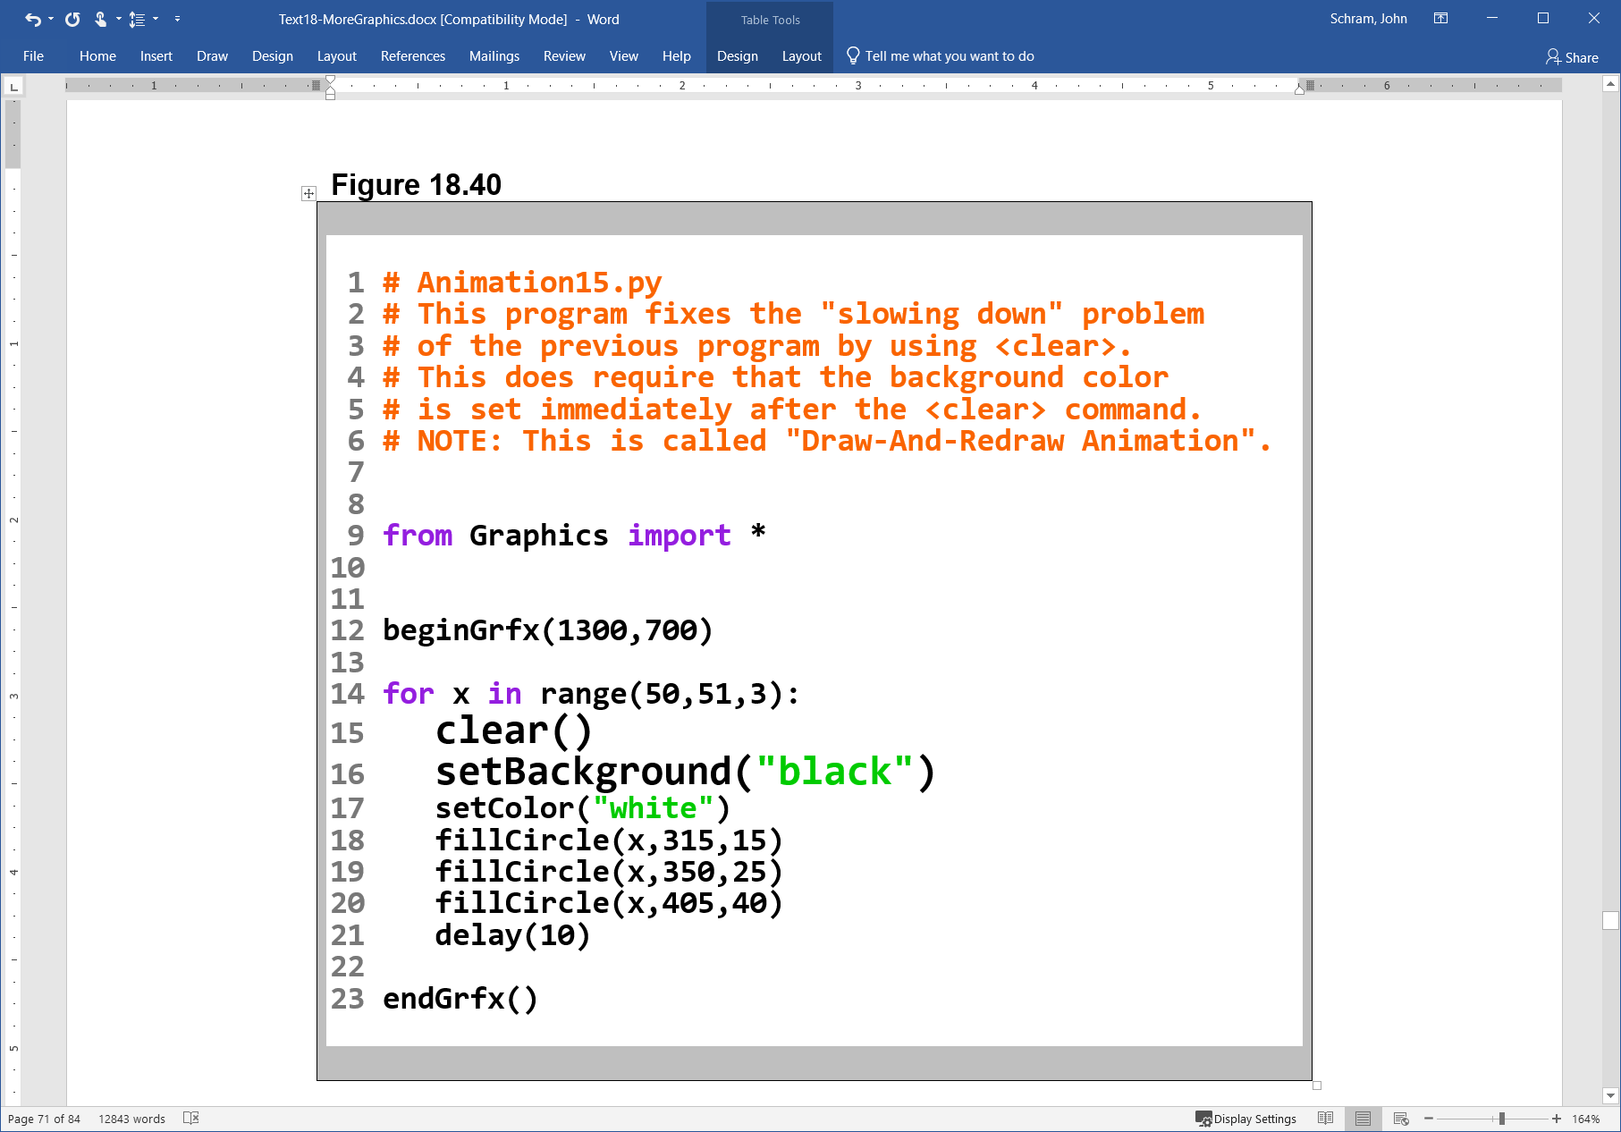


Slide 40
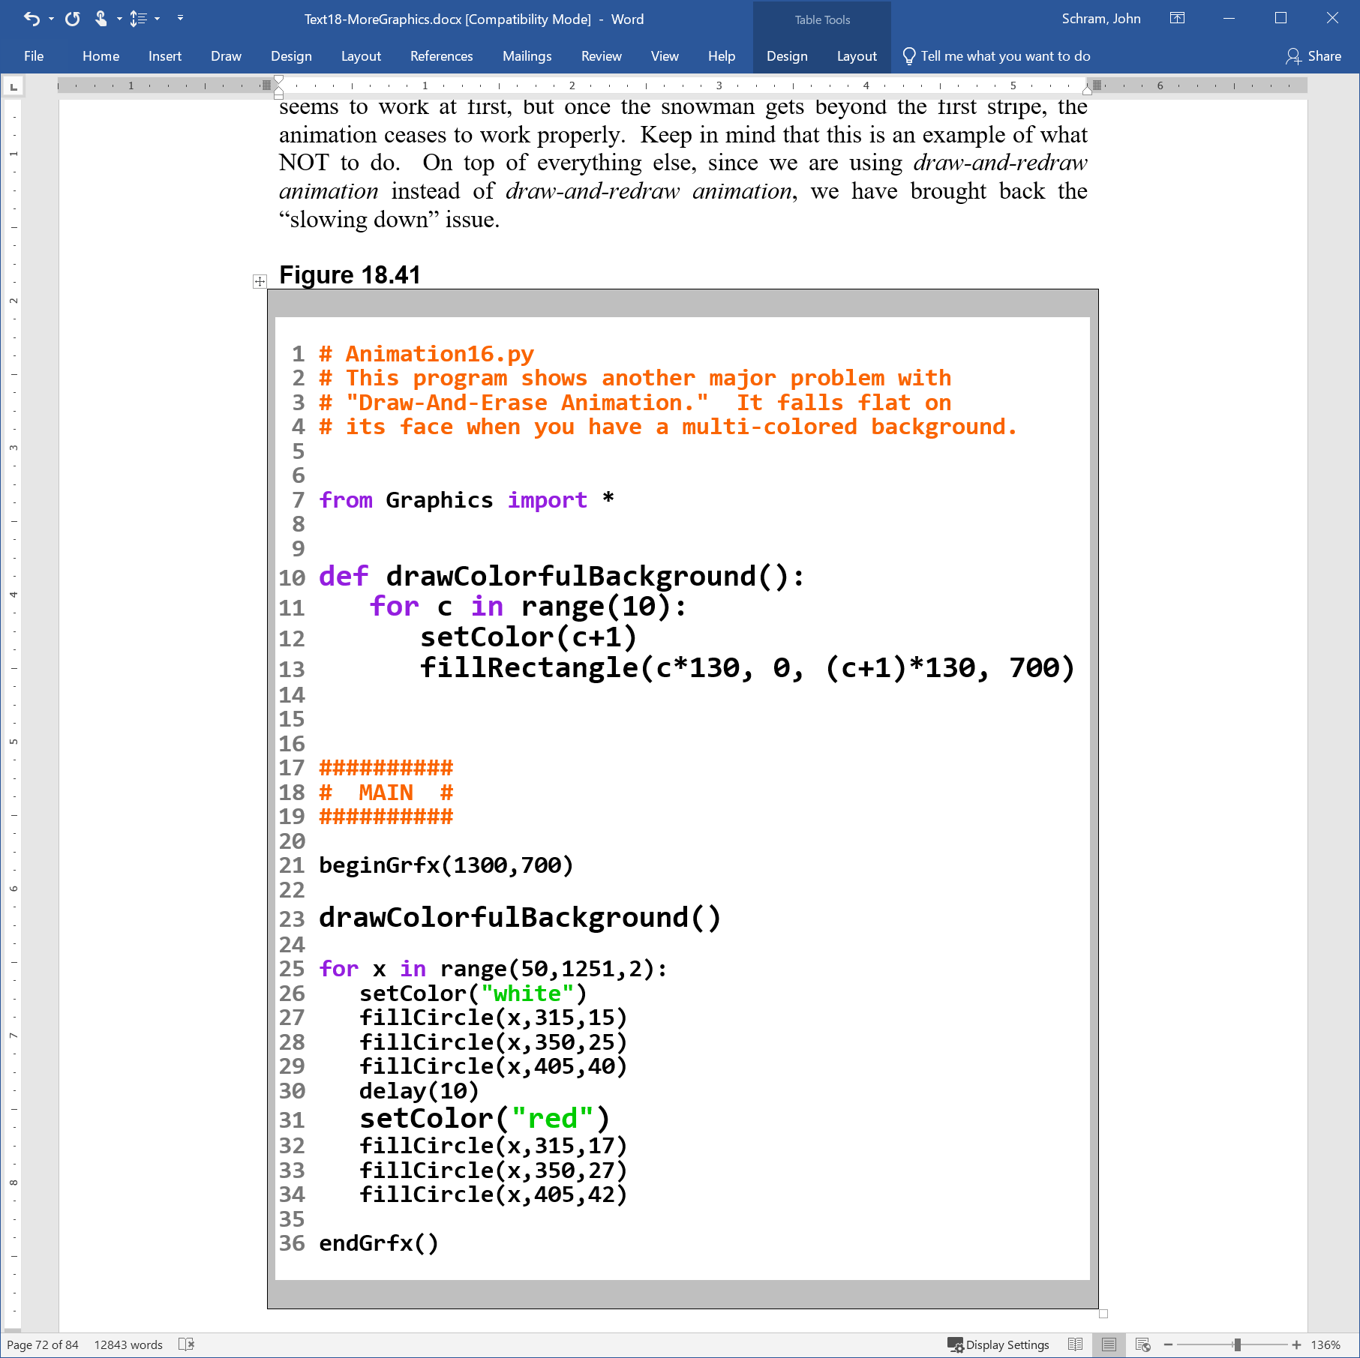


Slide 41
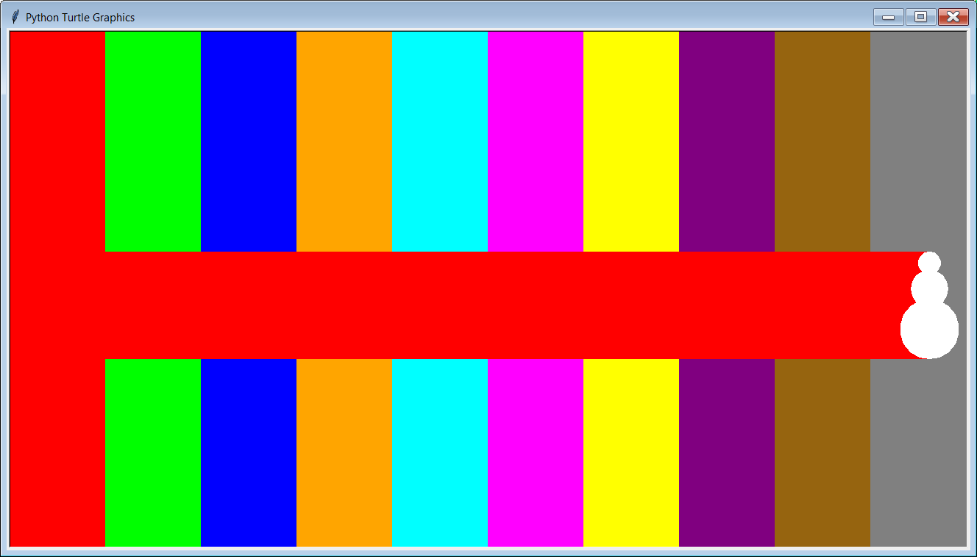

Slide 42
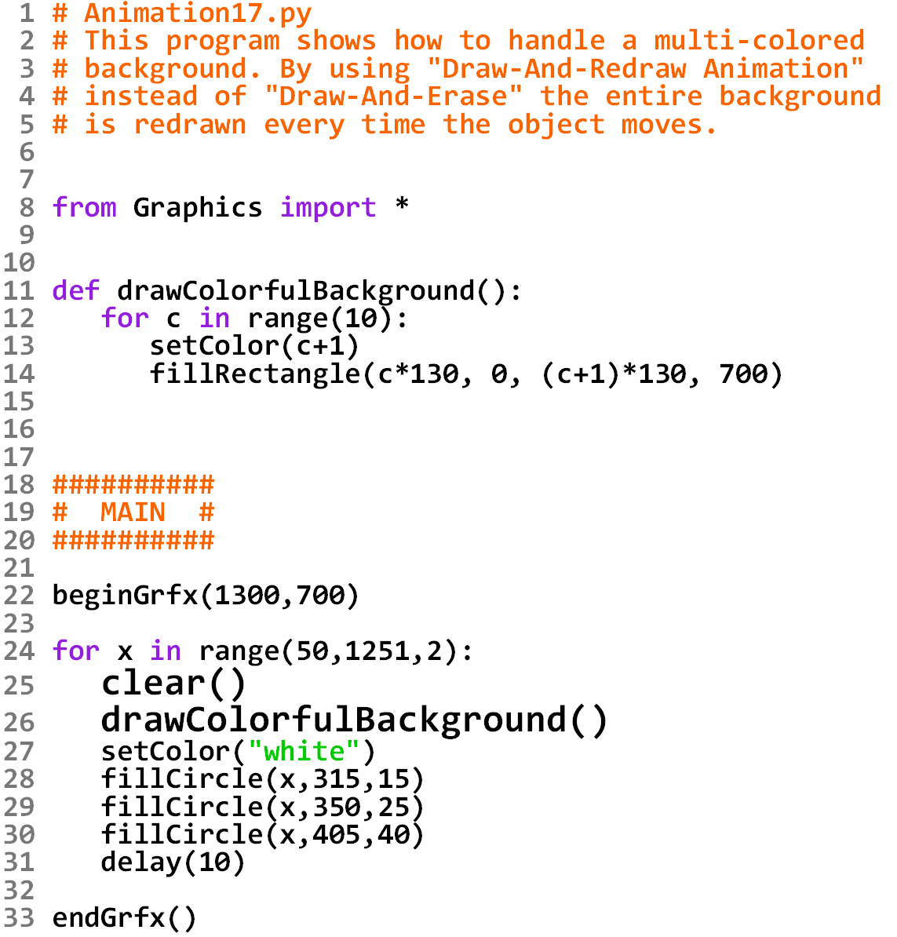


Slide 43


Slide 44
Draw-And-Redraw Animation Step-By-Step Review
1. Clear the screen.
2. Draw the entire background
(preferably by using a procedure).
3. Draw the foreground image.
4. Delay for a fraction of a second.
5. Repeat this process over and over each time drawing
the foreground image in a slightly different location.
This is the recommended approach for Computer Animation in our class because it solves BOTH of the problems of Draw and Erase Animation:
It works even if your background is not one solid color.
2. The animation will not slow down, even for complicated images.

Slide 45
Section 18.7
The Last Word

Slide 46
Programming Knowledge Never Becomes Obsolete
Some people may be concerned that with technology changing so rapidly, the programming knowledge that they have acquired in this course will soon be out of date. While new programming languages pop up from time to time, the logic of programming has never changed.
The next 6 programs all do the exact same thing:
The 1st is written in Python. The 2nd is in Java. The 3rd is in C++. The 4th is in Pascal; the 5th is in BASIC; and the 6th is written in VEXcode VR Blocks. Even though you may have never seen some of these languages before, you may be surprised how familiar these programs will look to you now that you know Python.

Slide 47


Slide 48


Slide 49


Slide 50


Slide 51


Slide 52


Slide 53


Slide 54


Slide 55



Slide 56





